Slide 1

Ubuntu
and basic Linux command part 1
Adapted and modified slides from Nguyen Quang Khai
Nov 2, 2025
hagiahuy311@gmail.com HuyHa

Slide 2
Contents
1. Introduction: Ubuntu, file systems, some terms.
2. Install tools, packages, apps on Ubuntu
3. Some alternative apps for Linux user: wps office, obs studio, chrome, discord…
4. Use Chat GPT in helping and learning code

Slide 3
Contents
1. Introduction: Ubuntu, file systems, some terms.
2. Some basic Linux commands work with files and directories.
- Change working directory.
- List content.
- Create.
- Remove.
- Copy.
- Move.

Slide 4
Introduction

Slide 5




Some popular Operating Systems

Slide 6





Distributions of linux (OS)
Ubuntu OS has the most users

Slide 7
Why linux in bioinformatics?
Linux is an open-source operating system.
- Allows users to customize their systems according to their specific needs.
- It is free.
Linux is the most commonly used operating system in High-Performance Computing (HPC). HPC unlocks primary challenges in bioinformatics:
- Data processing limits.
- Slow analysis times.
- Impact on research progress.
Most bioinformatics tools and applications are designed to be run on Linux-based operating systems.

Slide 8
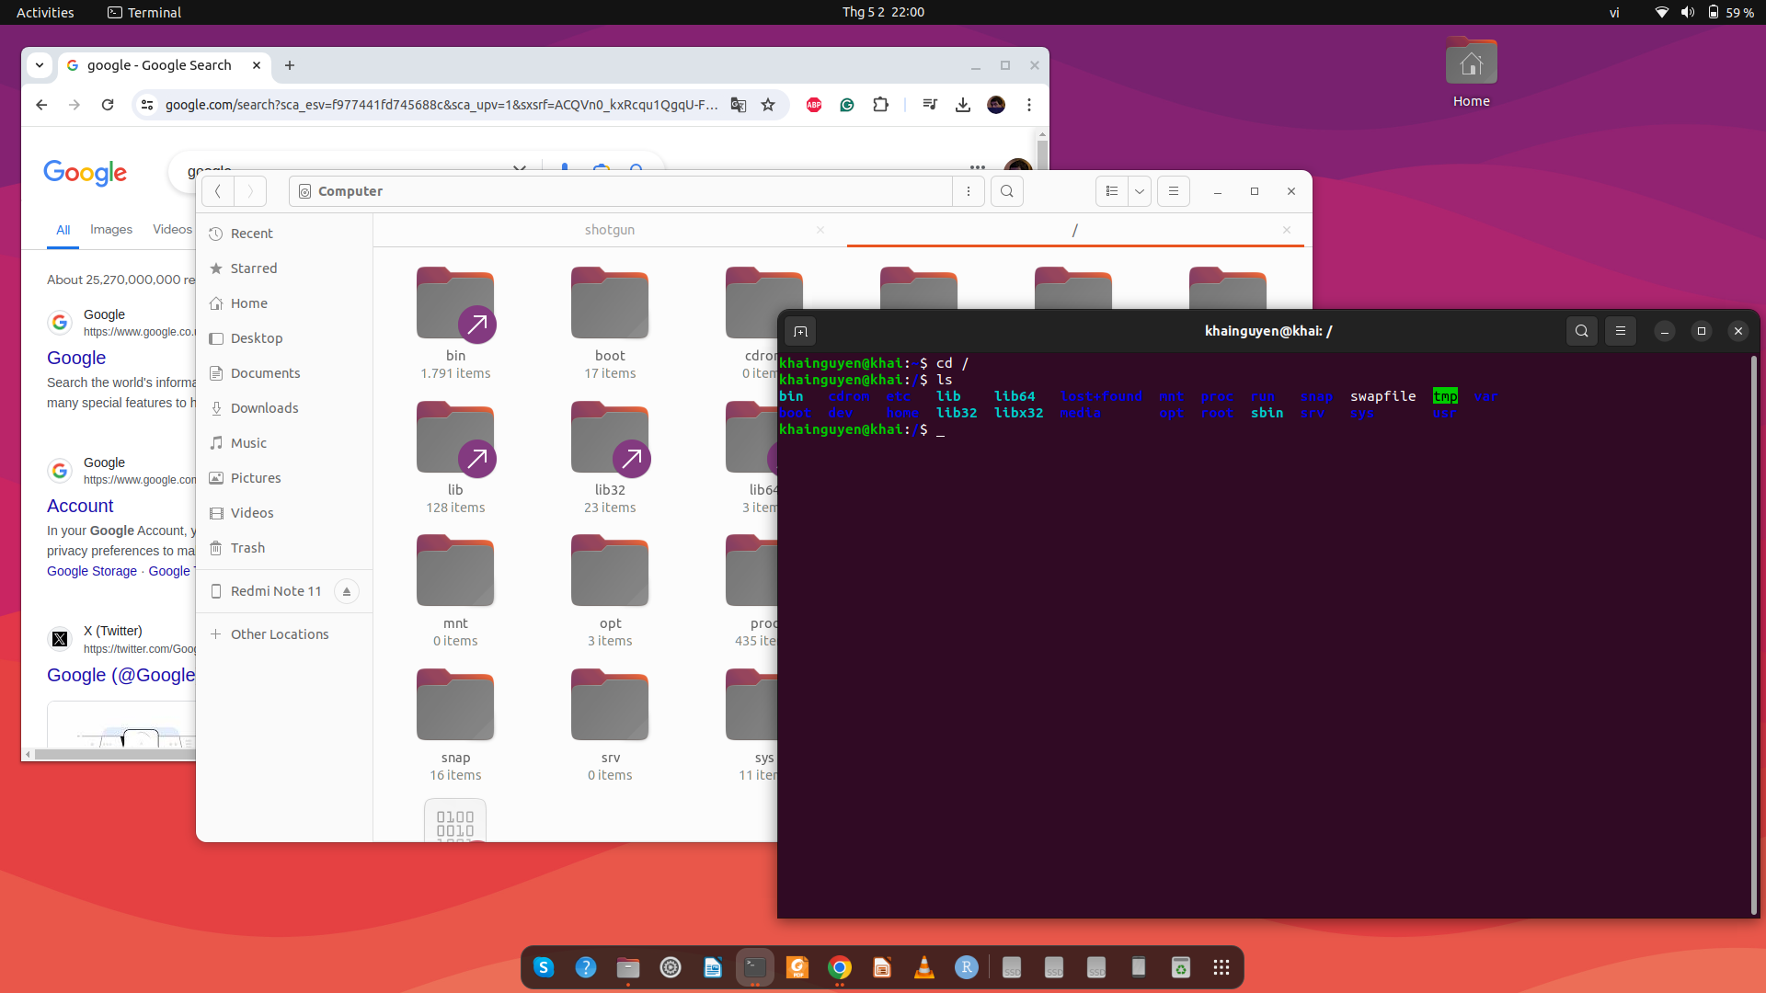
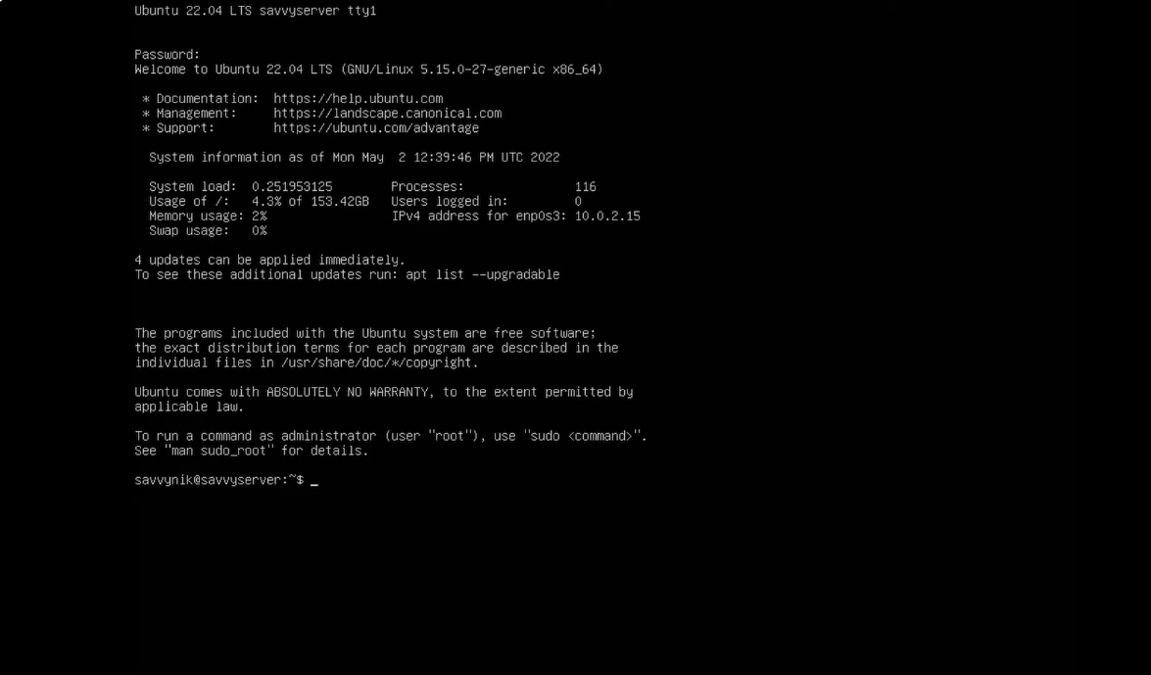
interact with the software/package
graphic user interface - GUI
(mouse + keyboard)
also called
command line interface - CLI
(keyboard)
Ubuntu desktop: GUI + CLI
Ubuntu server: only CLI

Slide 9
Terminal
Terminal window
is where you type commands
Open:
Ctrl + Alt + T keys on the keyboard
Ubuntu desktop

Slide 10
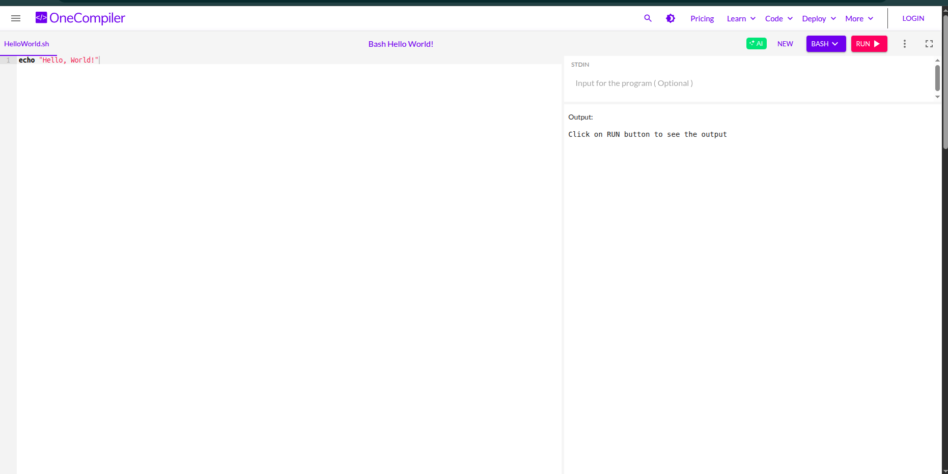
https://onecompiler.com/bash

Slide 11
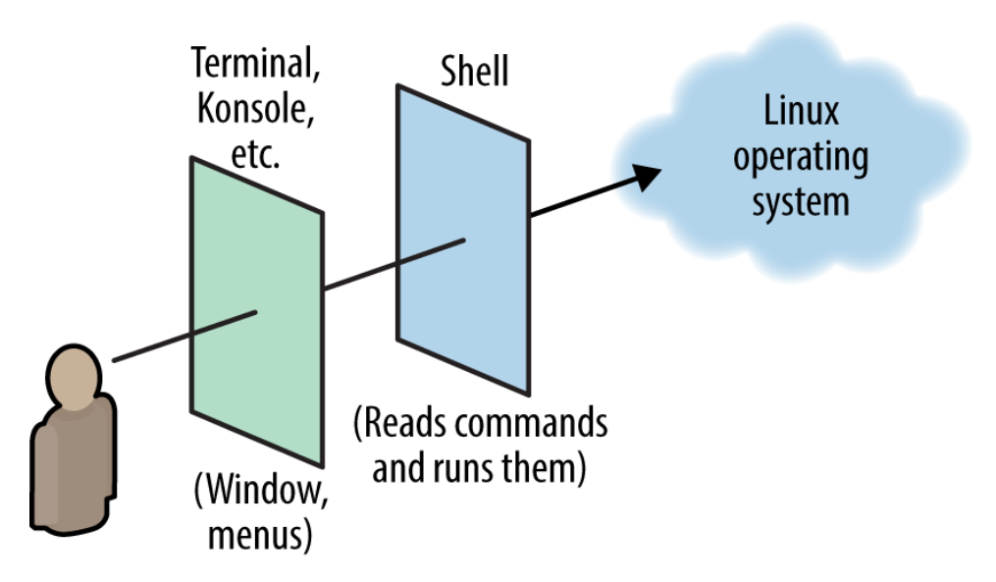

What is Shell?
- A shell is a special user program that provides an interface for the user to use operating system services.
- Terminal is where we interact with the shell through commands.
- Several types of Shell:
+Bourne Shell (sh)
+ C Shell (csh)
+Bourne Again Shell (bash): most popular
+ Z Shell (zsh)
(Daniel J. Barrett, Linux pocket guide)

Slide 12
Some ways to get the Terminal
easy to install
1.
macOS: How to open Terminal:
https://support.apple.com/en-vn/guide/terminal/apd5265185d-f365-44cb-8b09-71a064a42125/mac
Windows 10/11: Install Ubuntu on Windows Subsystem for Linux (WSL): Recommended for beginners
https://canonical-ubuntu-wsl.readthedocs-hosted.com/en/latest/guides/install-ubuntu-wsl2/
2. Install Ubuntu on virtual machine (VM):
Windows: Install Ubuntu on VirtualBox: https://www.youtube.com/watch?v=ngJQPt-xEeo
macOS: Install Ubuntu on VirtualBox: https://www.youtube.com/watch?v=b_tOialCSXE
3. Install Ubuntu on physical computer: Best for long term use
Delete Windows & install Ubuntu: https://www.youtube.com/watch?v=oZcvqfWf_ps&t=100s
If you don't want to delete windows:
or a) Dual boot: Ubuntu and Windows on the same hard drive:
https://www.youtube.com/watch?v=GXxTxBPKecQ&t=229s
or b) Dual boot: Ubuntu and Windows on the separate hard drive:
(Ubuntu on hard drive 1, Windows on hard drive 2)
https://www.youtube.com/watch?v=KX85vZ3ANVk
Recommended method b) if you want dual-boot.
Warning: backup your data before install!!
More reference: https://www.youtube.com/watch?v=oZcvqfWf_ps&t=100s
a bit difficult to install

Slide 13
Step by step in install dual boot ubuntu
1 Download Ubuntu
2 Flashing the Image to a USB
3 Shrinking Storage Space for Ubuntu
4 Booting into USB using BIOS
5 Changing Boot Order in BIOS
6 Starting the Ubuntu Installation
7 Customizing Partition Setup
8 Continuing Setup Process
9 Selecting Between Windows & Ubuntu
10 Checking out Ubuntu
11 Exploring the Desktop
12 Congrats on Ubuntu & Win Setup

Slide 14
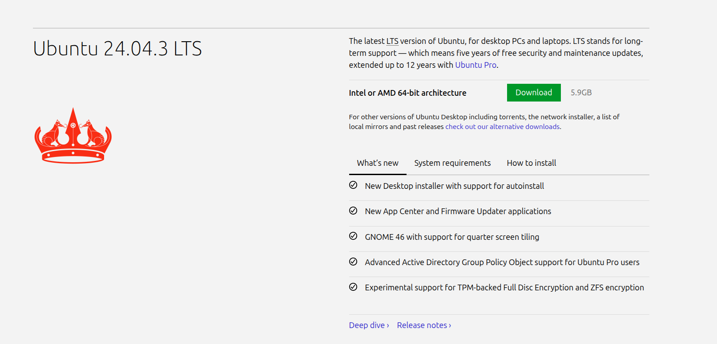
1 Download Ubuntu
https://ubuntu.com/download/desktop

Slide 15
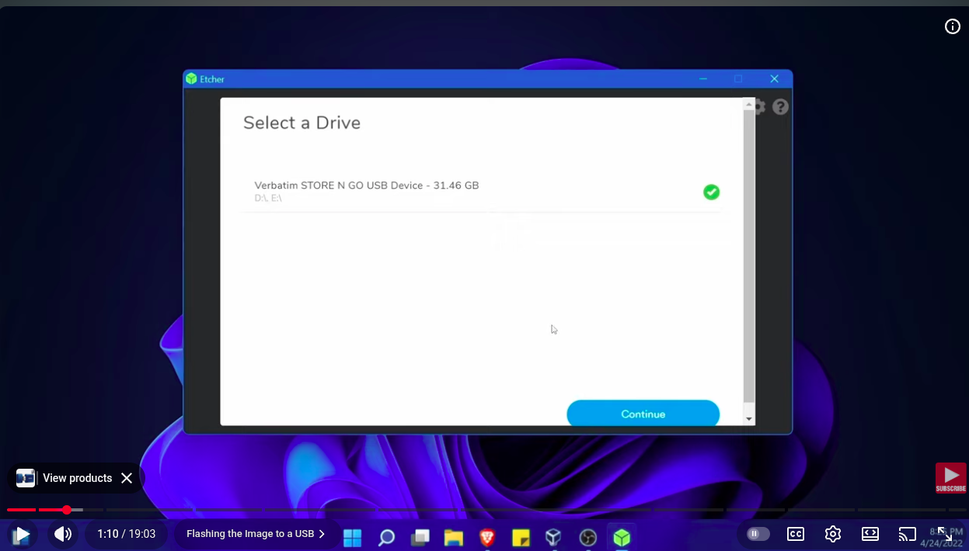
2 Flashing the Image to a USB

Slide 16
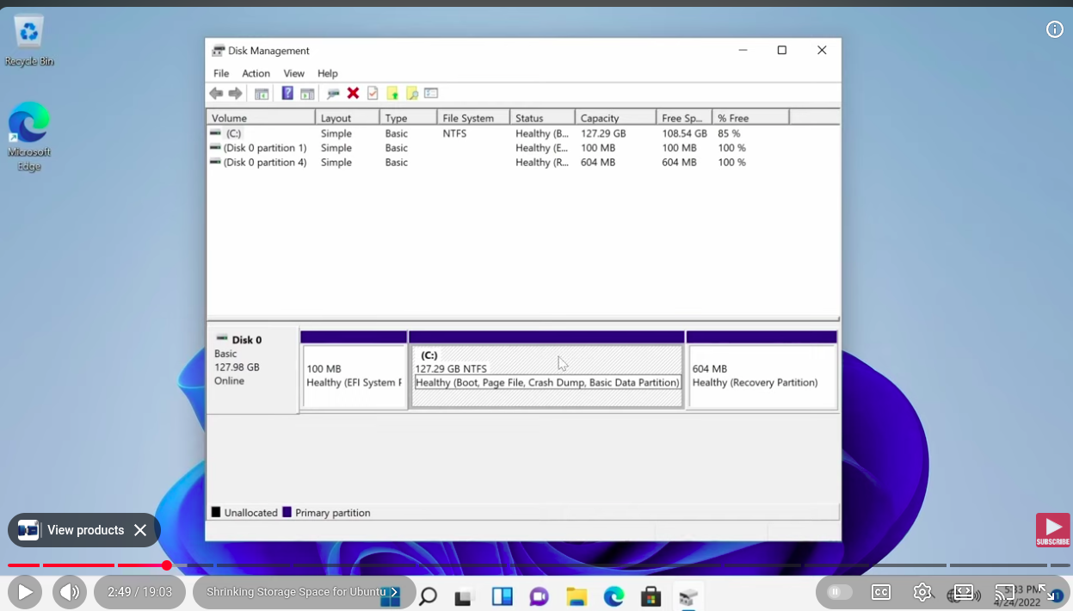
3 Shrinking Storage Space for Ubuntu

Slide 17
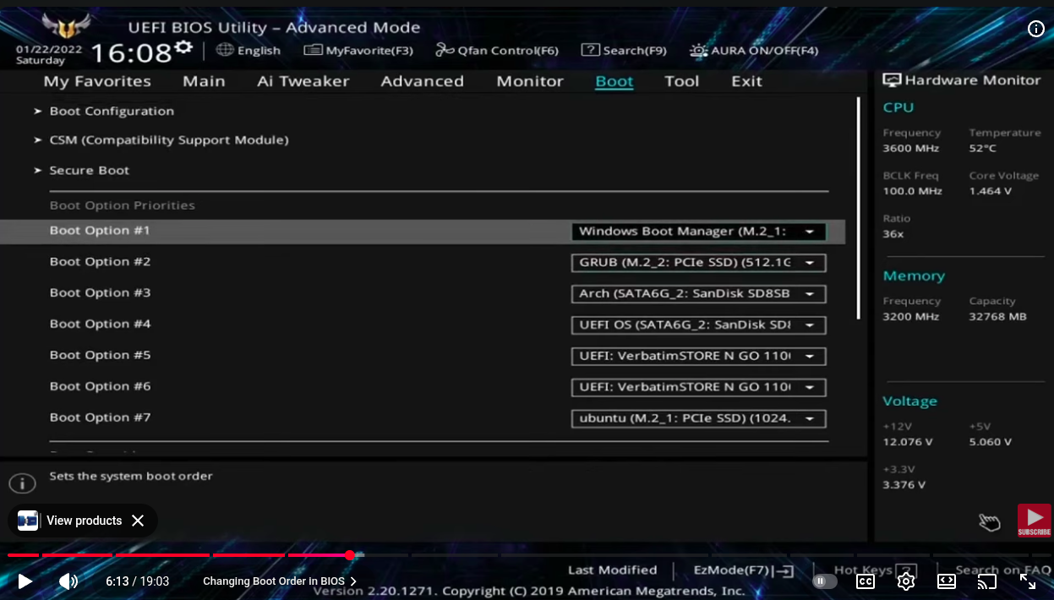
4 Booting into USB using BIOS
5 Changing Boot Order in BIOS

Slide 18
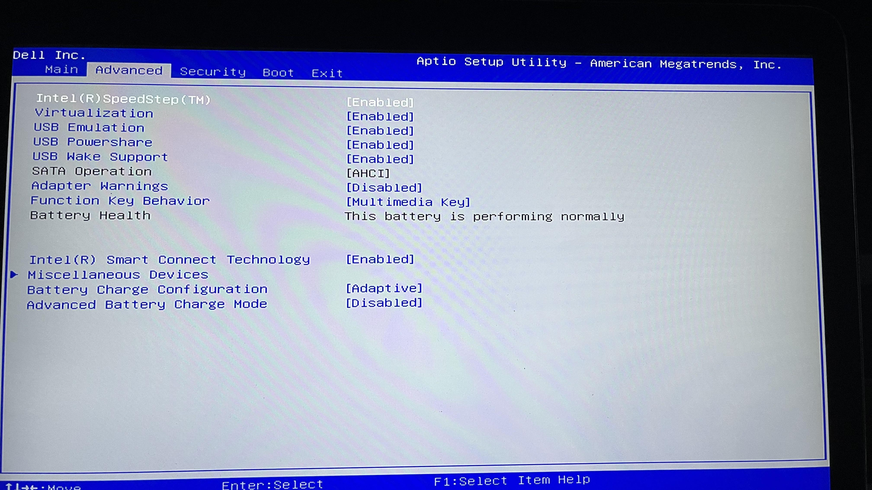

Slide 19
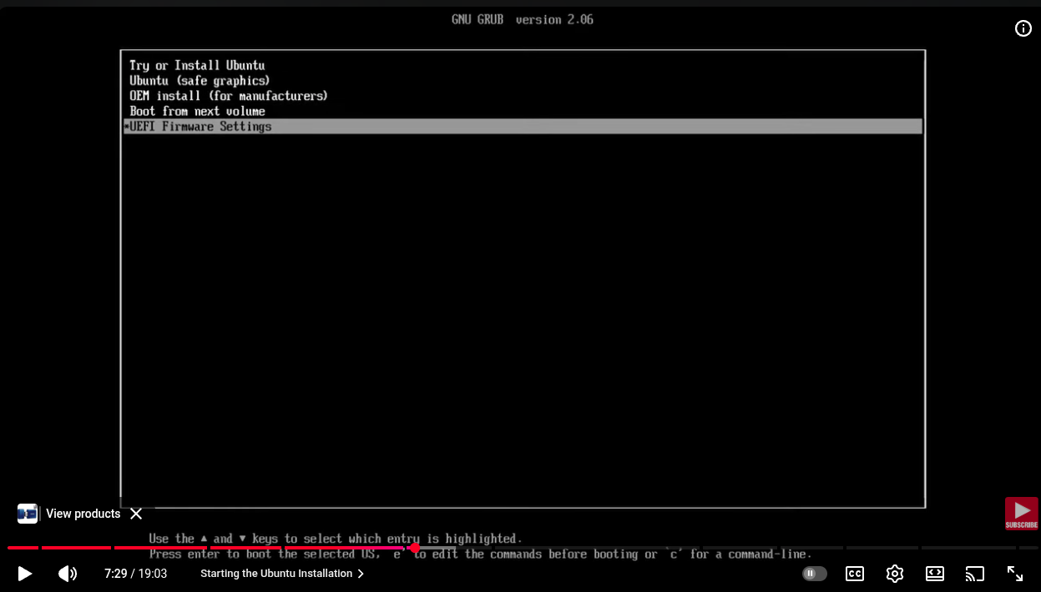
6 Starting the Ubuntu Installation

Slide 20
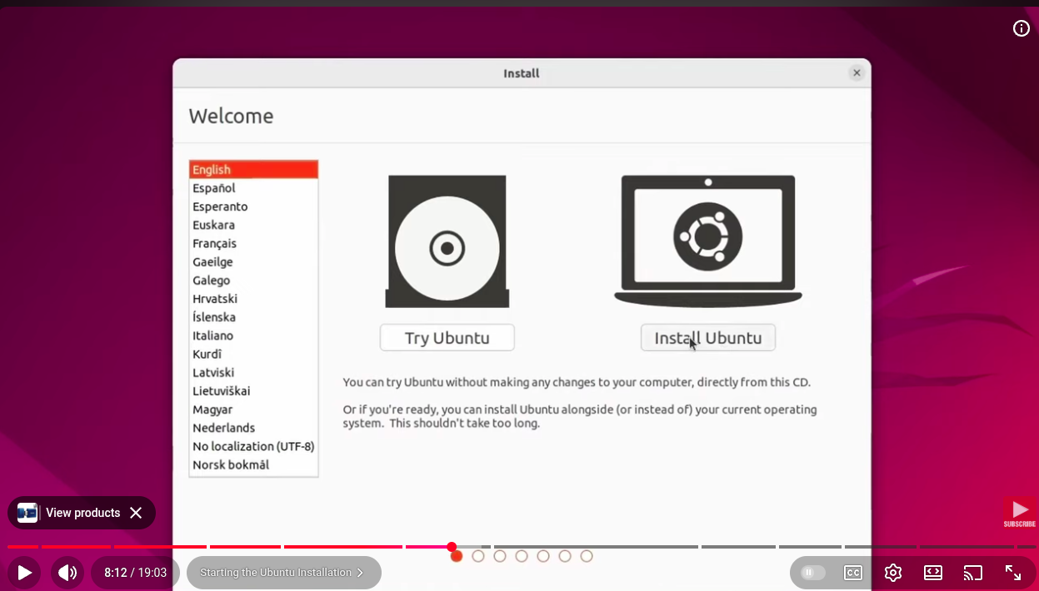
6 Starting the Ubuntu Installation

Slide 21
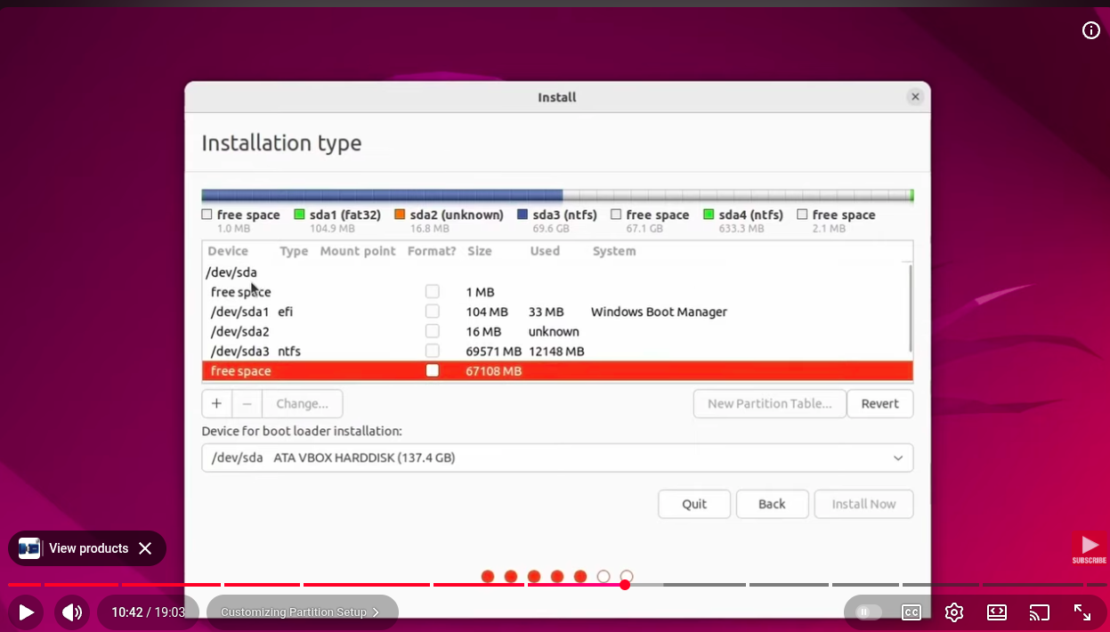
7 Customizing Partition Setup

Slide 22
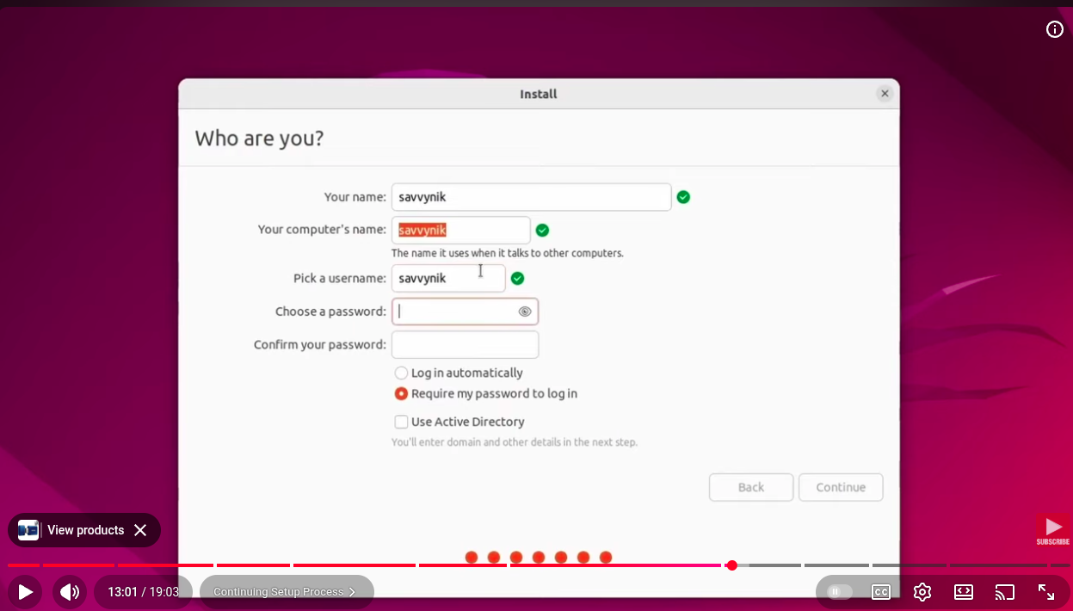
8 Continuing Setup Process

Slide 23
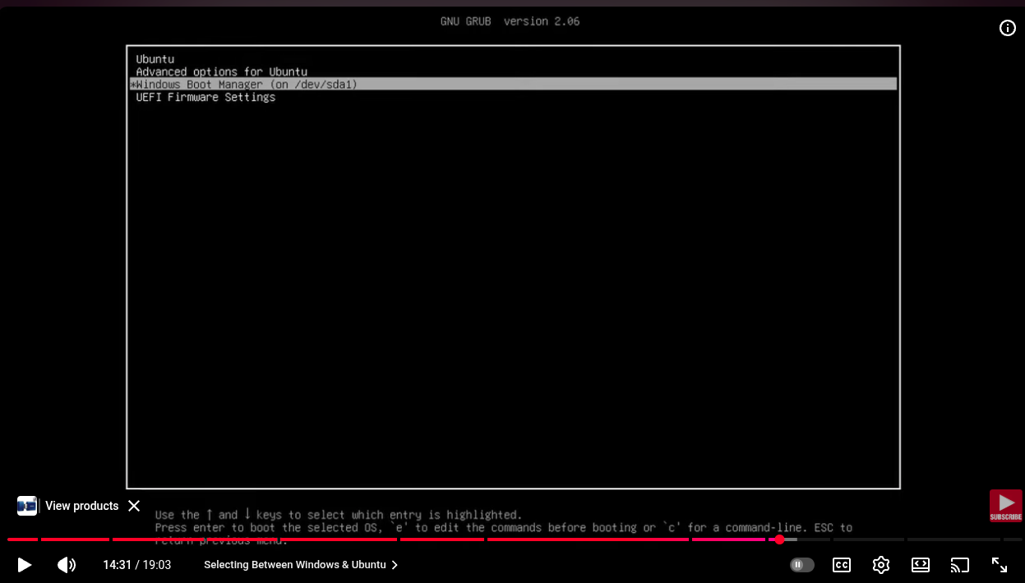
9 Selecting Between Windows & Ubuntu

Slide 24
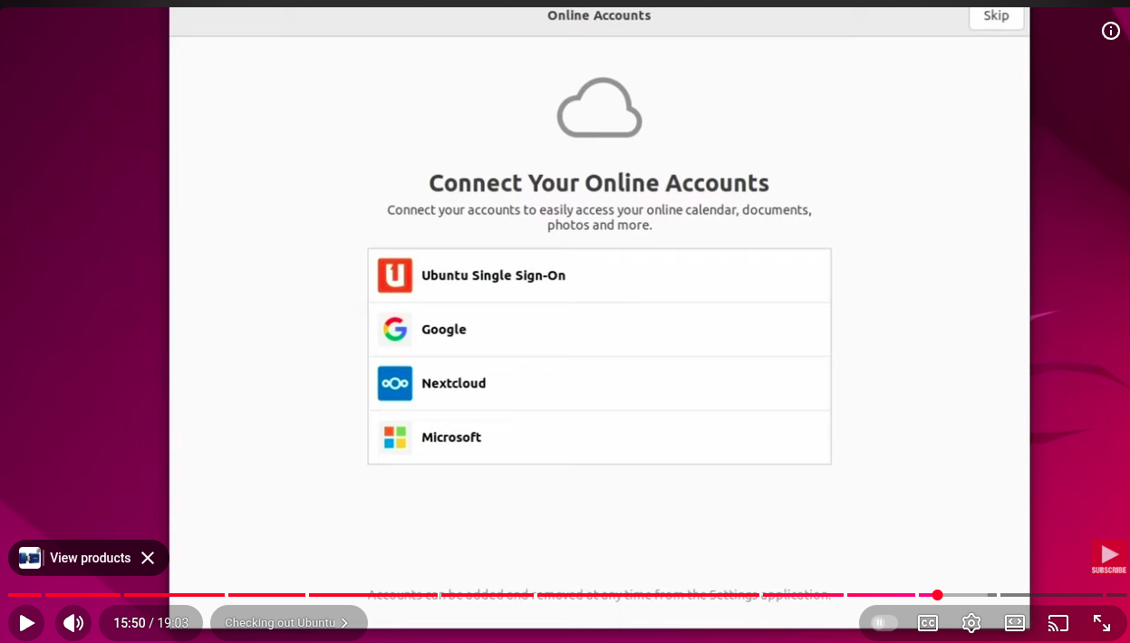
10 Checking out Ubuntu

Slide 25
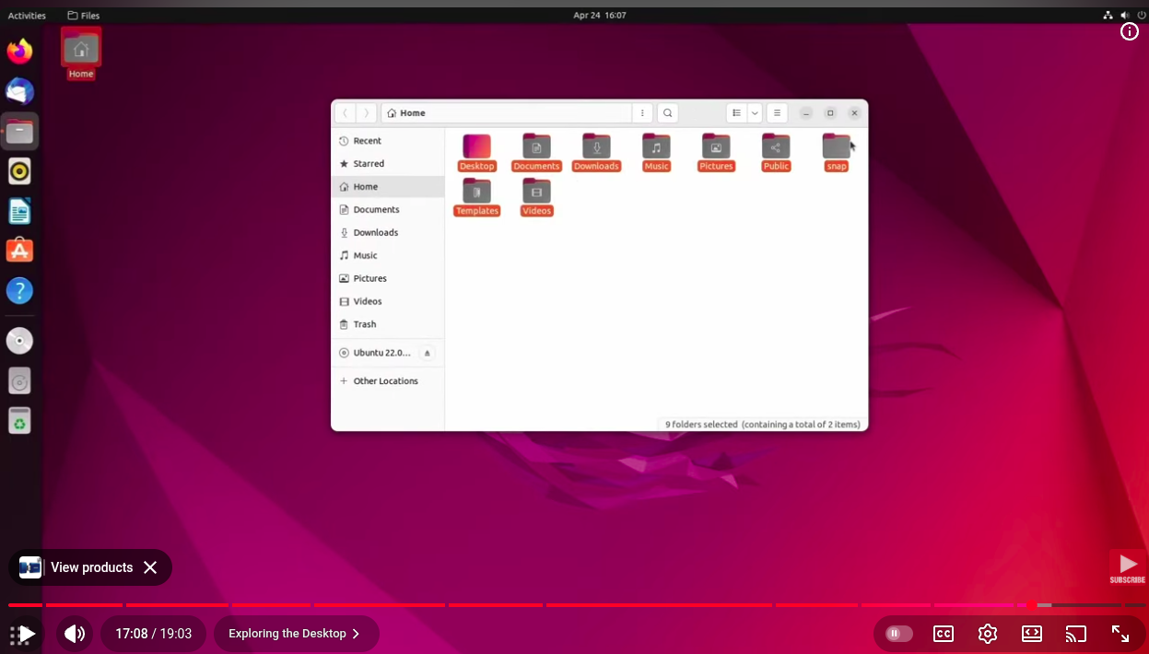
11 Exploring the Desktop

Slide 26


Slide 27


Slide 28


Slide 29
How to install tools?
🧩 1. APT (Advanced Package Tool) — default Ubuntu method
🧪 2. Micromamba / Conda — isolated environments
📦 3. Snap packages
🧱 4. .deb packages (Debian installer files)
🐧 5. Manual install from source (build yourself)
🧰 6. Python tools via pip
🐋 7. Docker or Singularity/Apptainer containers
🧮 8. Install from PPA (Personal Package Archive)

Slide 30
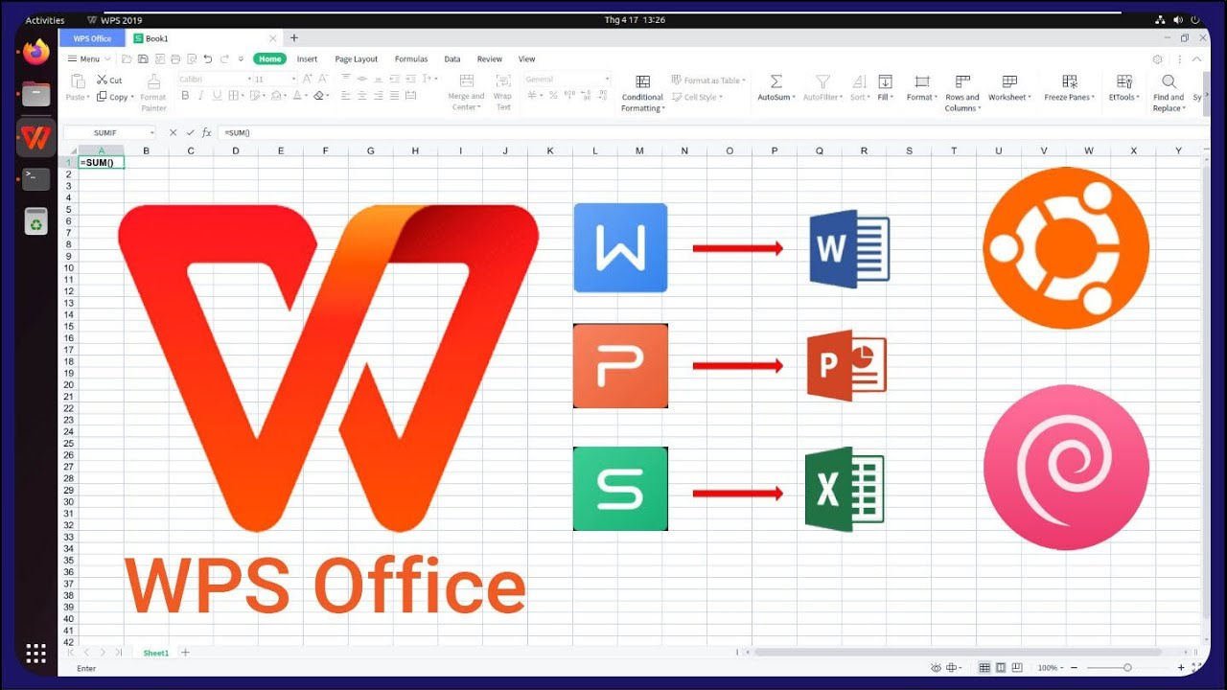

Slide 31
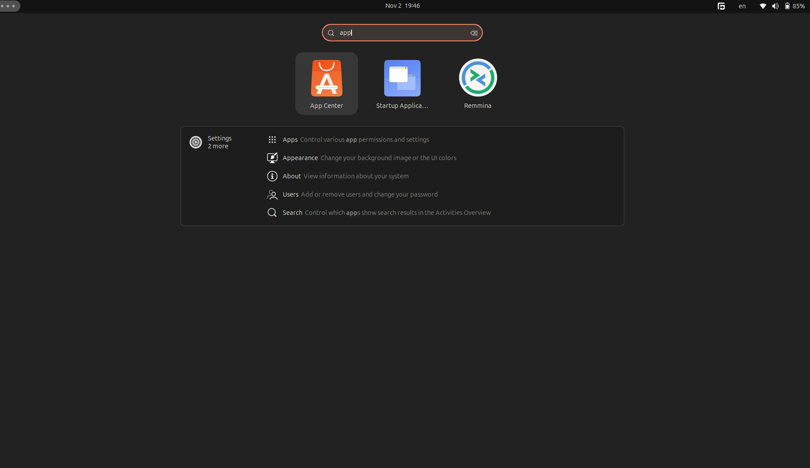
12 Congrats on Ubuntu & Win Setup

Slide 32
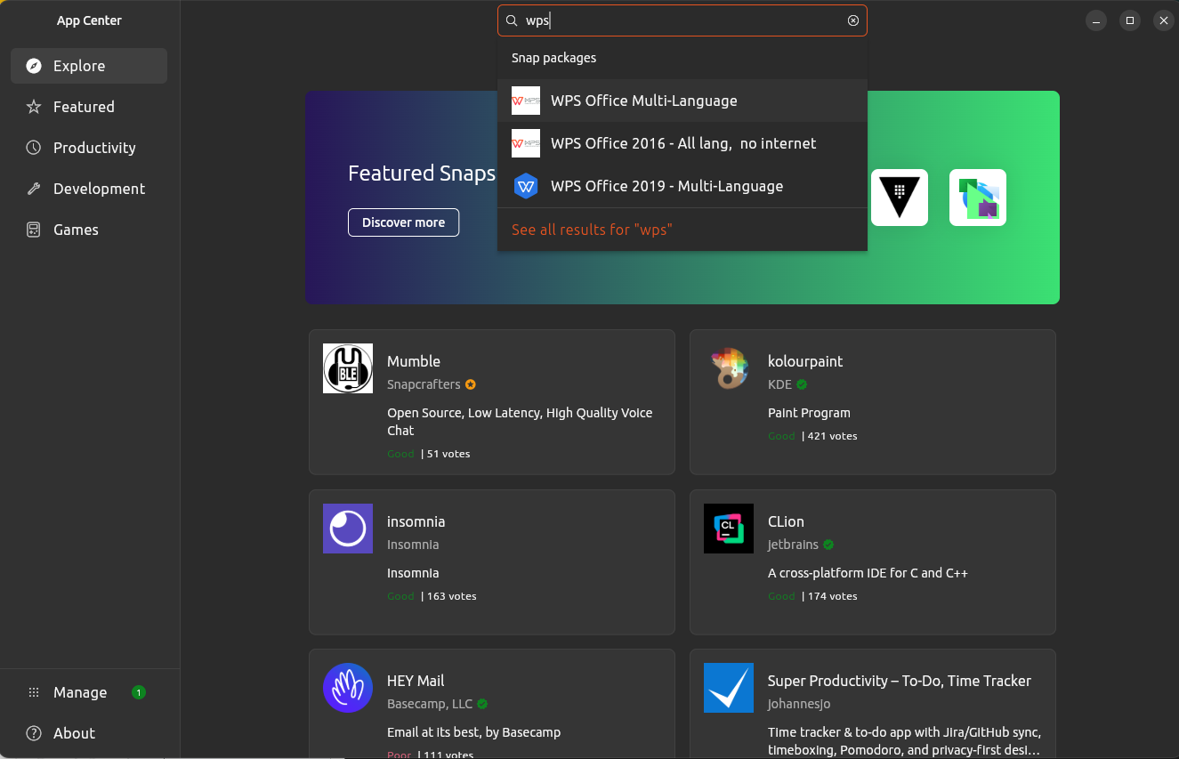

Slide 33
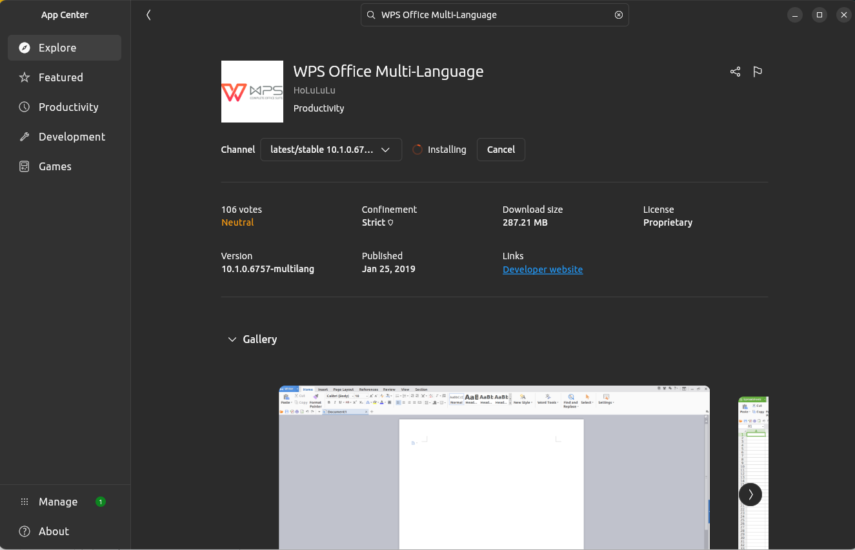

Slide 34
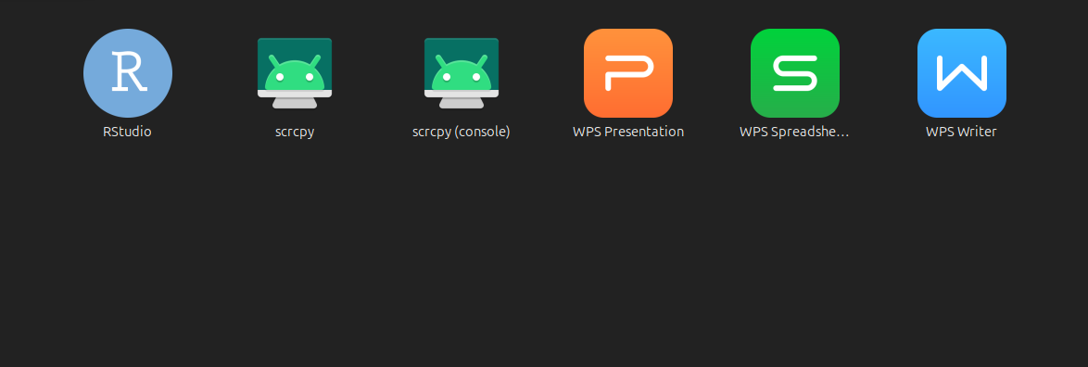
App in desktop

Slide 35
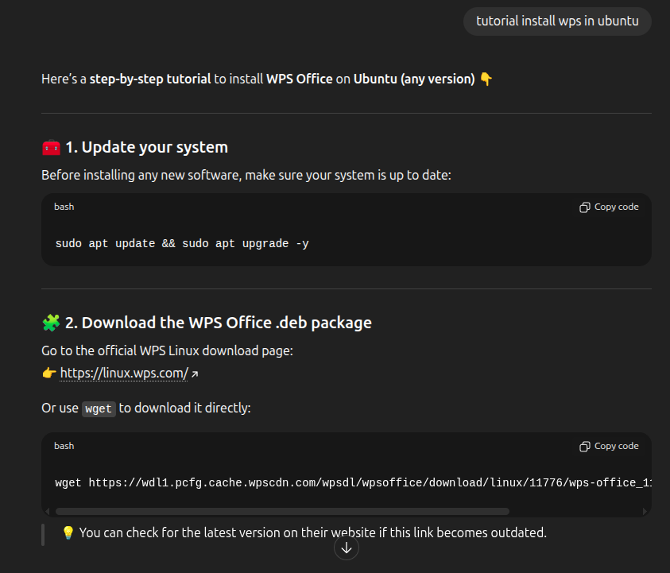
Install WPS Office with support of Chat GPT

Slide 36
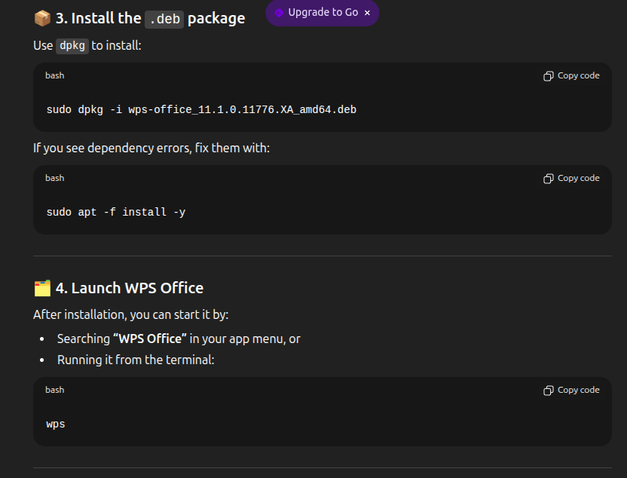

Slide 37
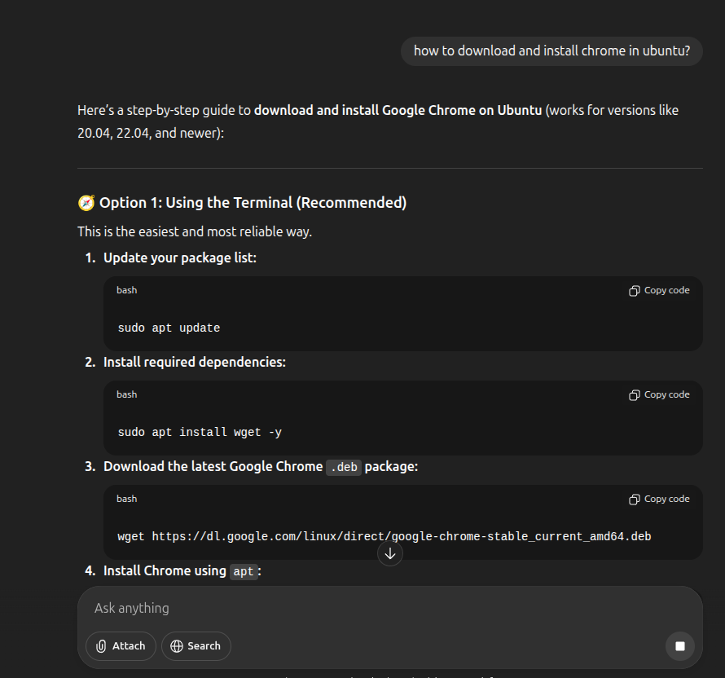
Install Chrome with support of Chat GPT

Slide 38
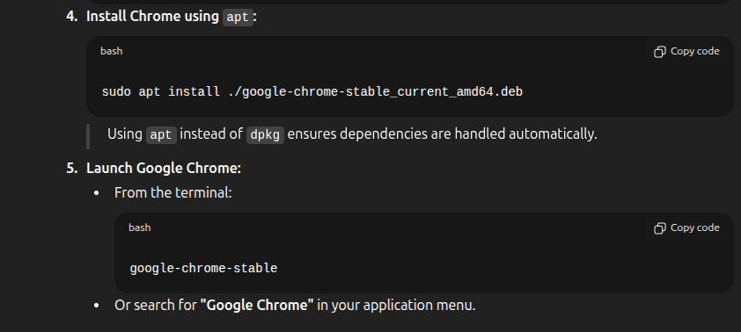
Install Chrome with support of Chat GPT

Slide 39
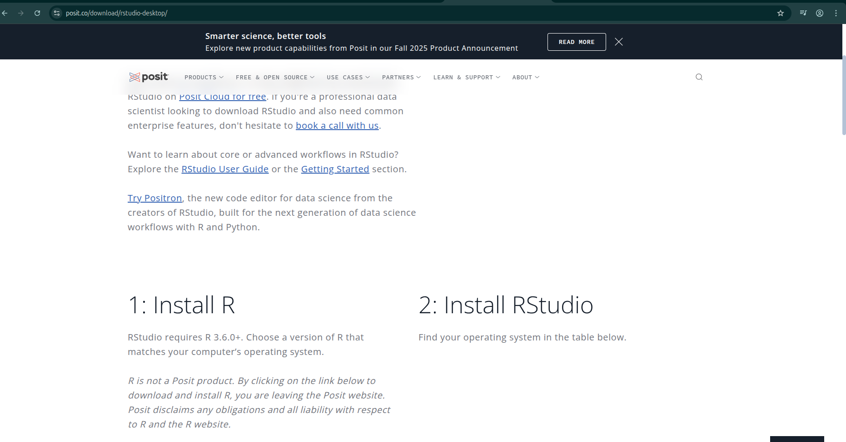
Install R and Rstudio
https://posit.co/download/rstudio-desktop/

Slide 40
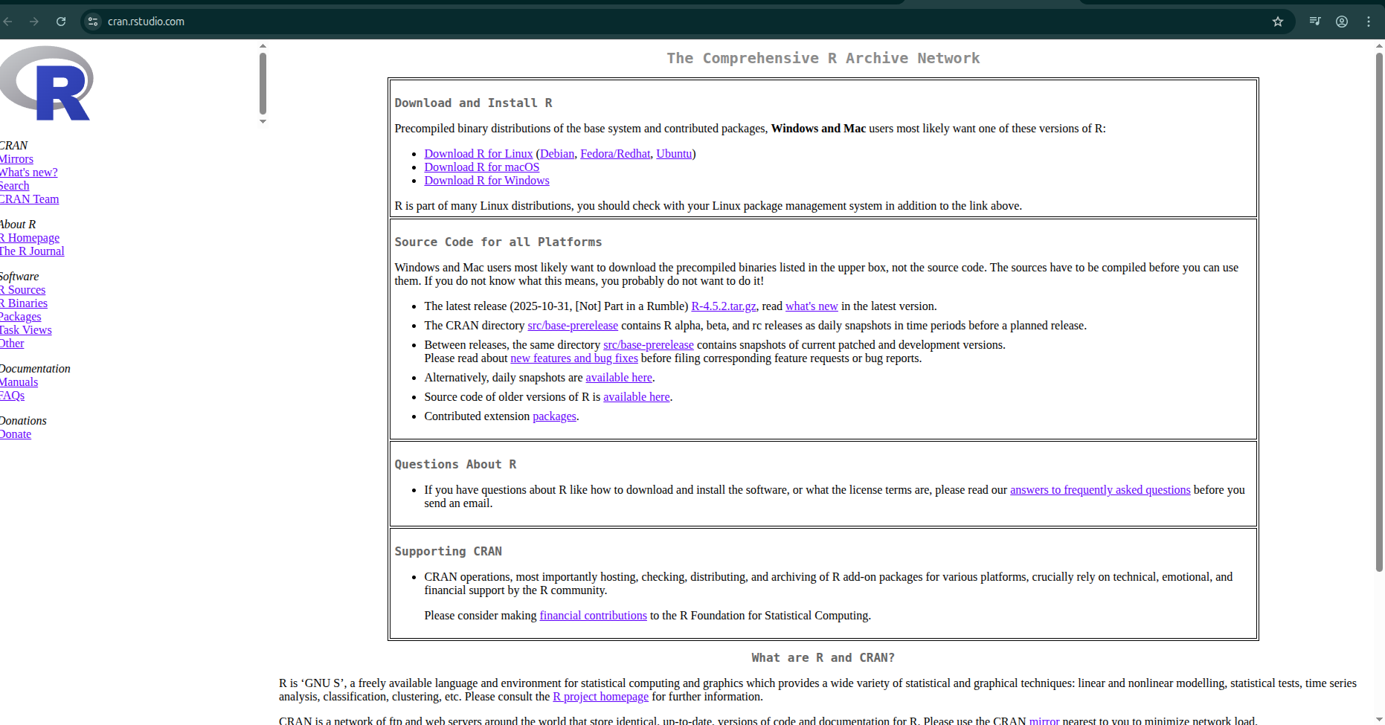
Install R
https://cran.rstudio.com/

Slide 41
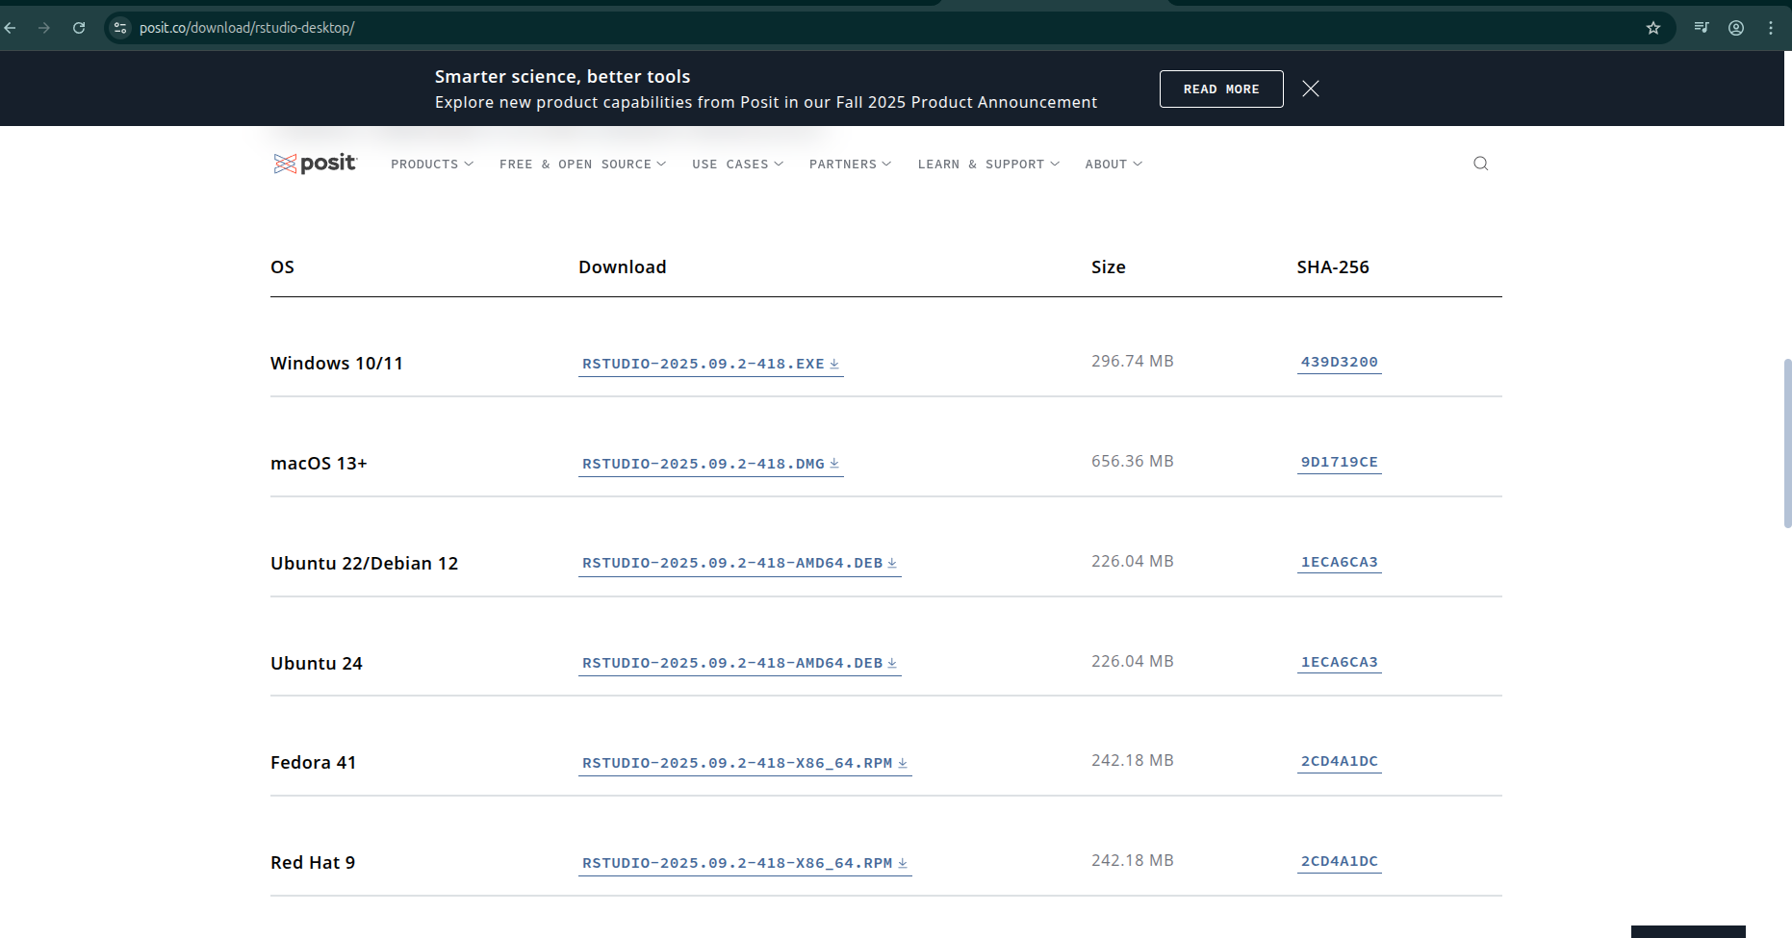
https://posit.co/download/rstudio-desktop/

Slide 42

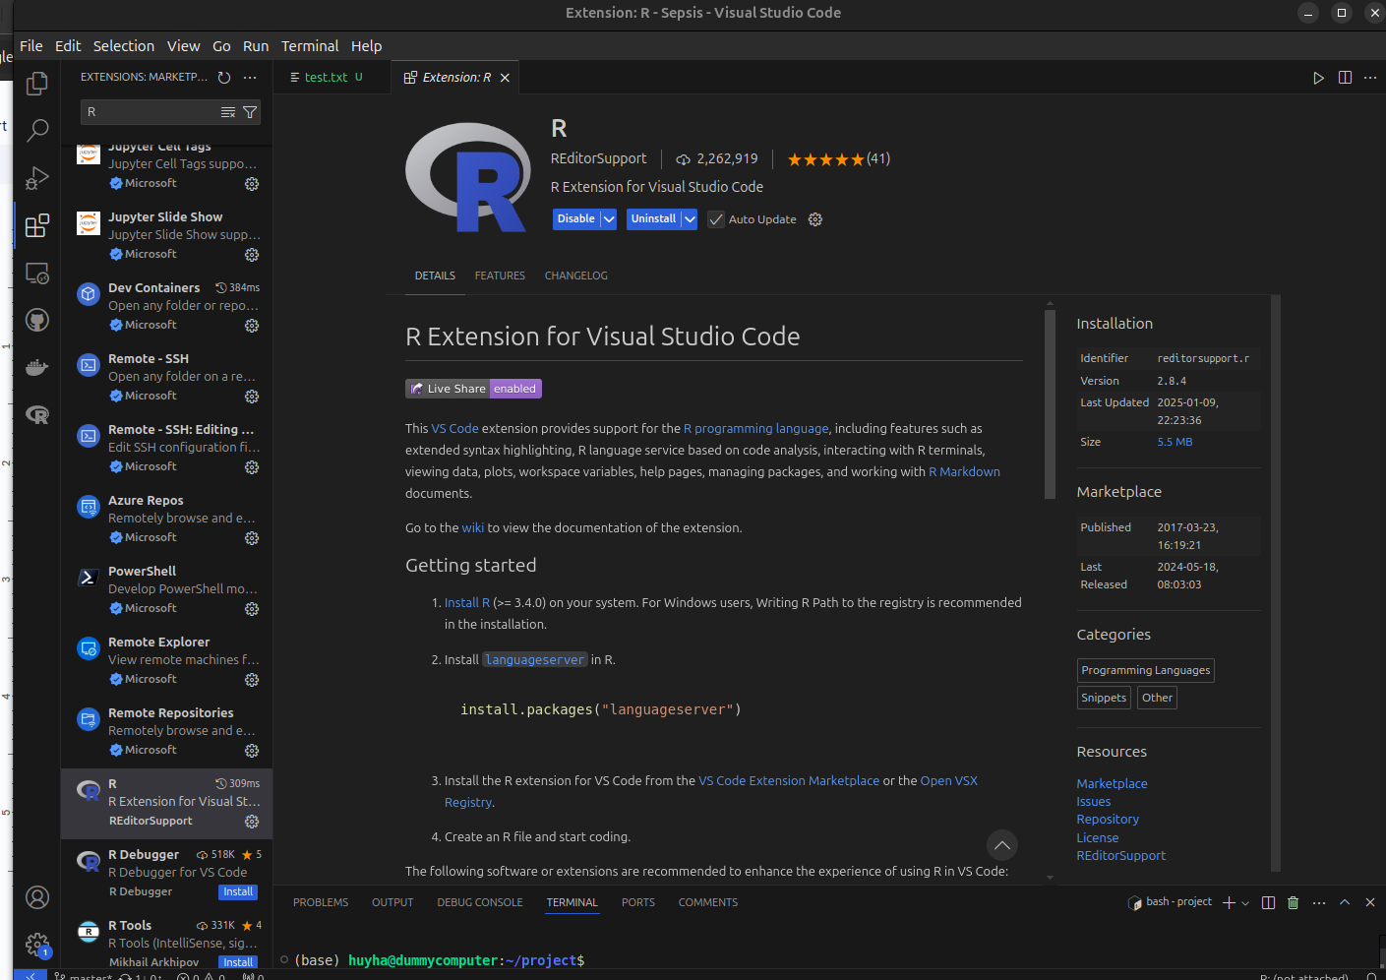
Orthers platforms for R
Visual code
https://code.visualstudio.com/download

Slide 43

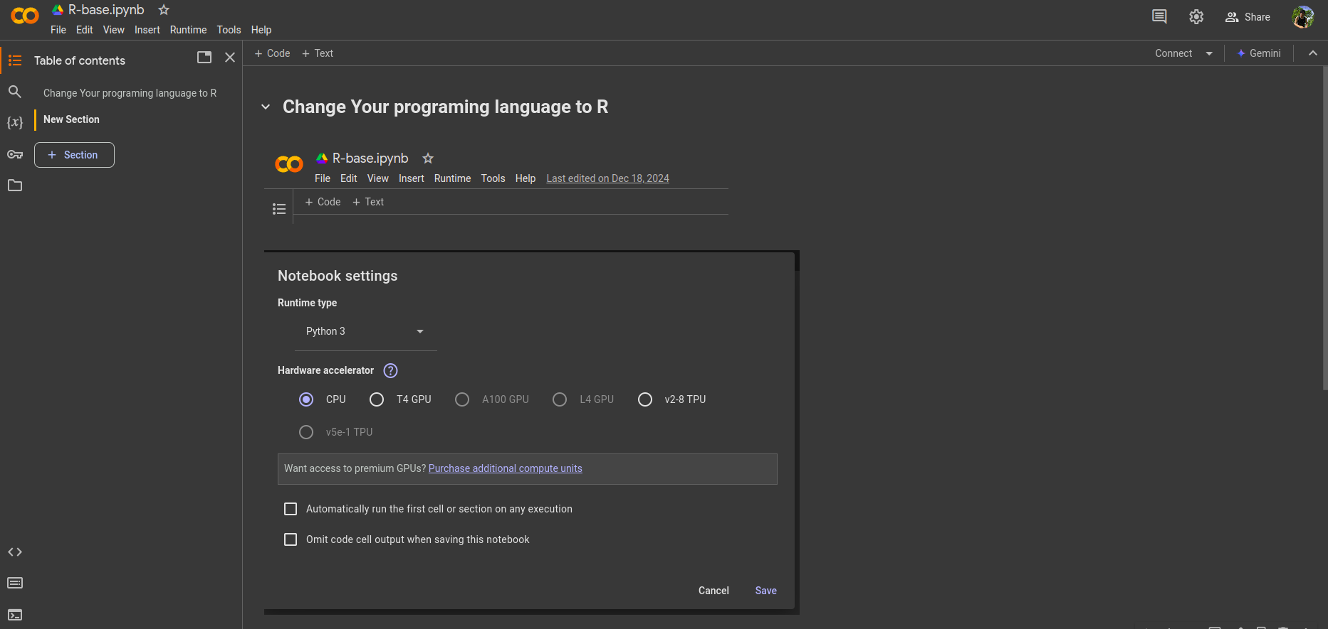
Orthers platforms for R
Google colab
https://colab.research.google.com

Slide 44
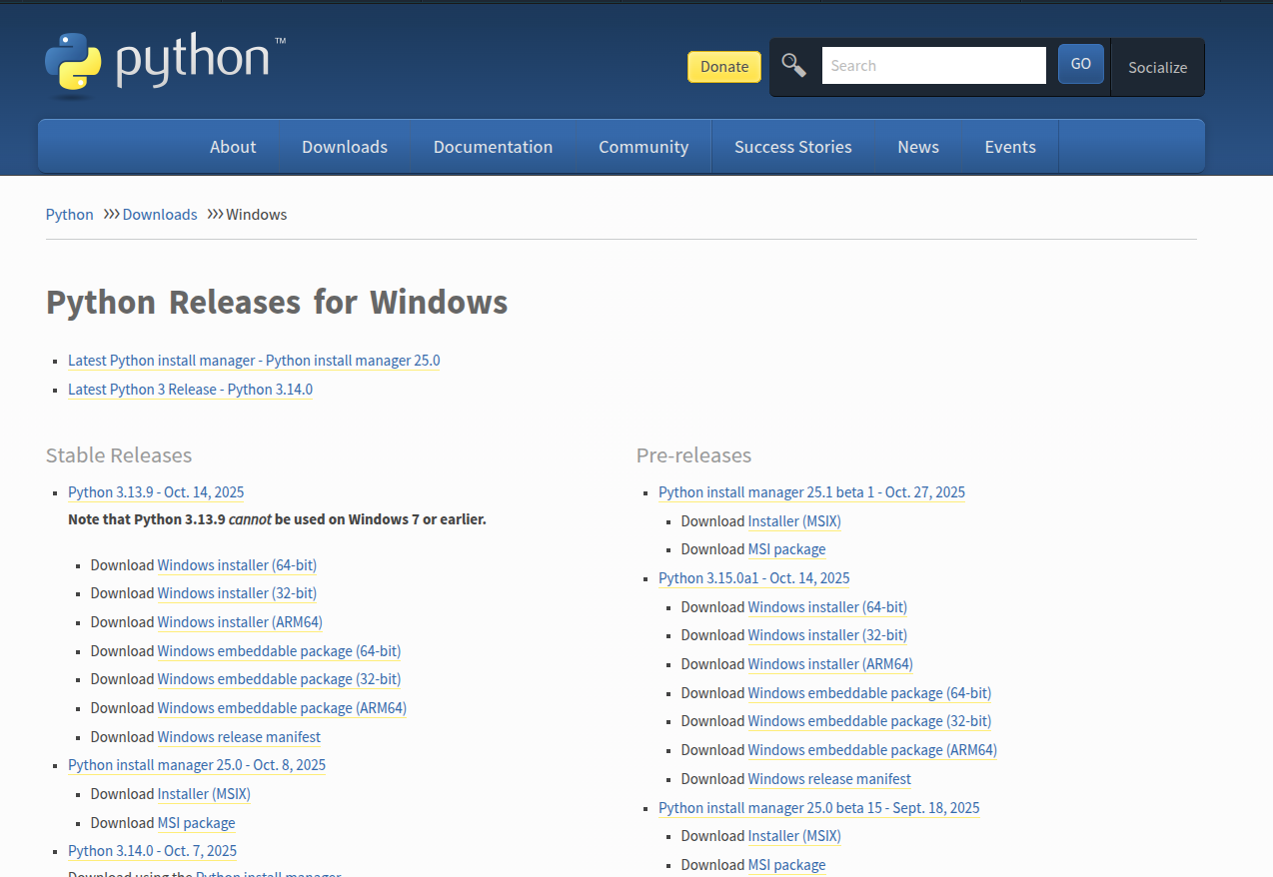
Python for window
https://www.python.org/downloads/windows/

Slide 45
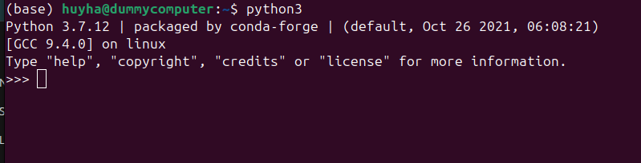
Tools version

Slide 46
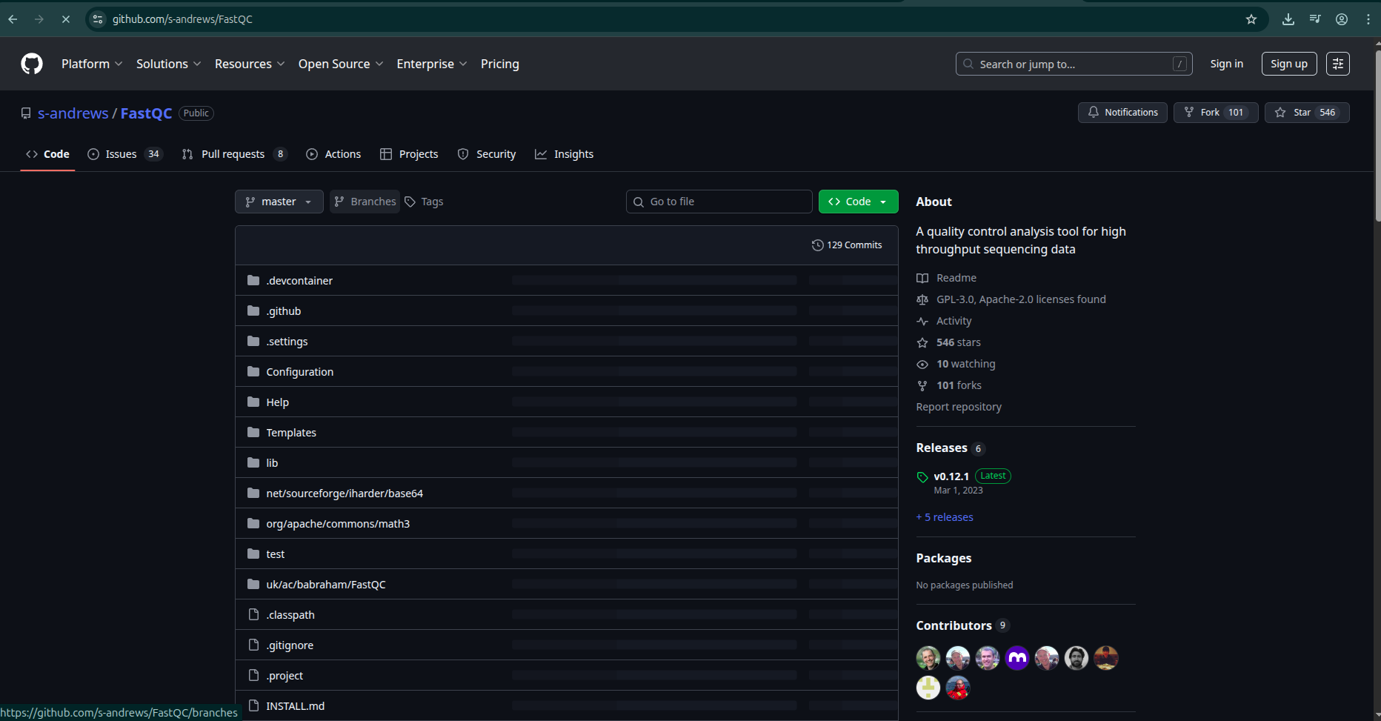
https://github.com/s-andrews/FastQC

Slide 47
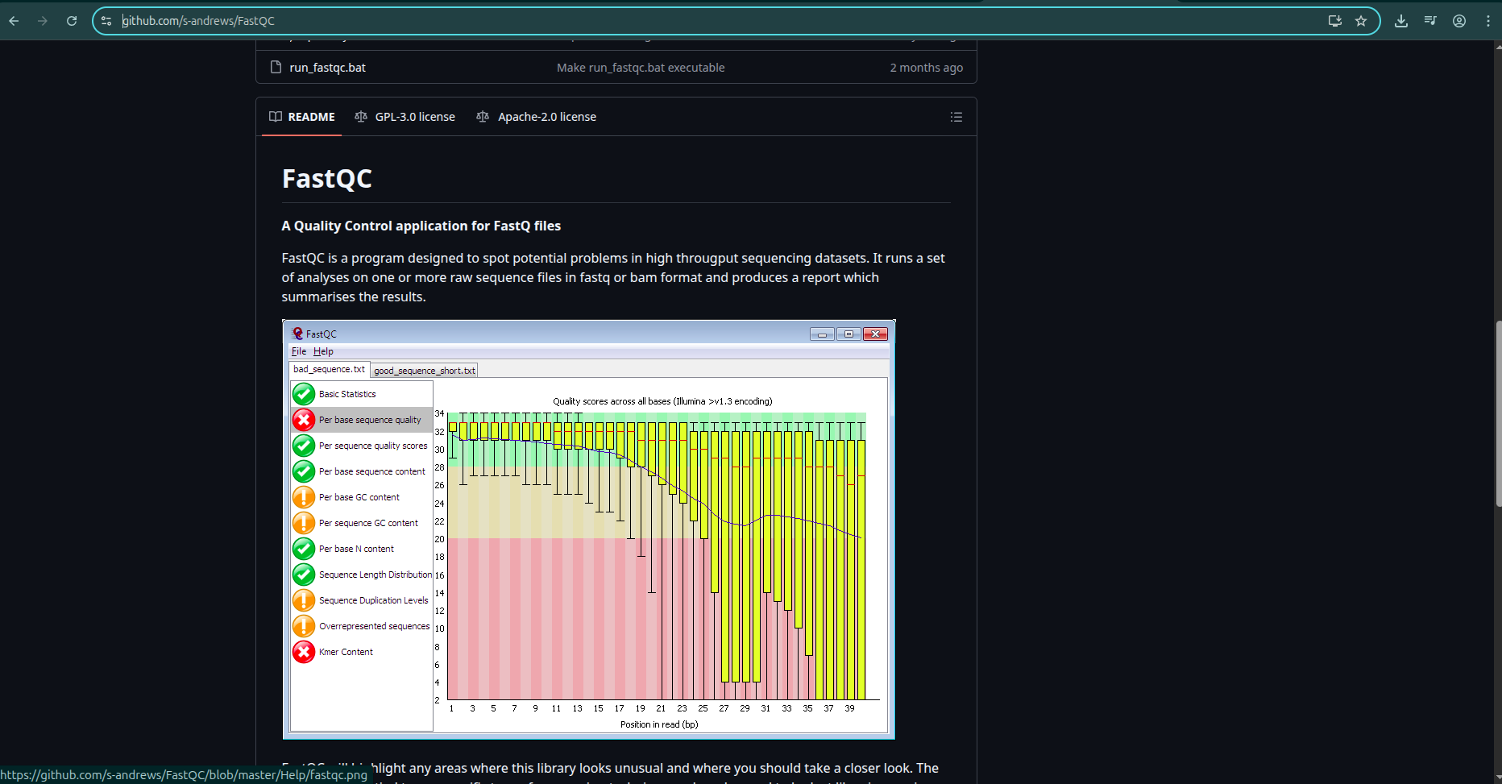
https://github.com/s-andrews/FastQC

Slide 48
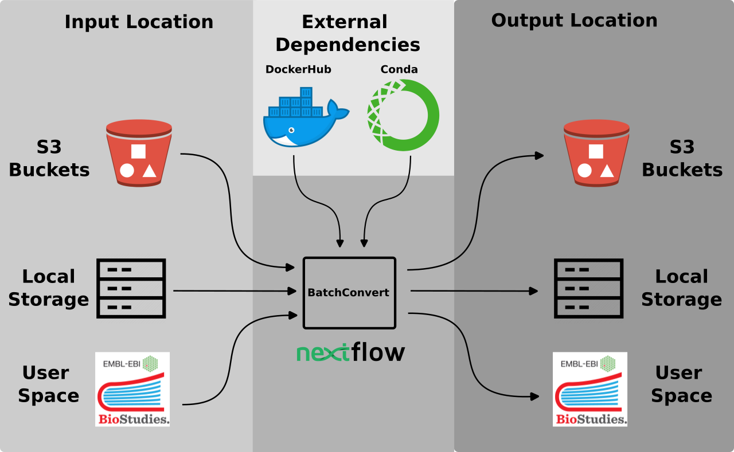

Slide 49
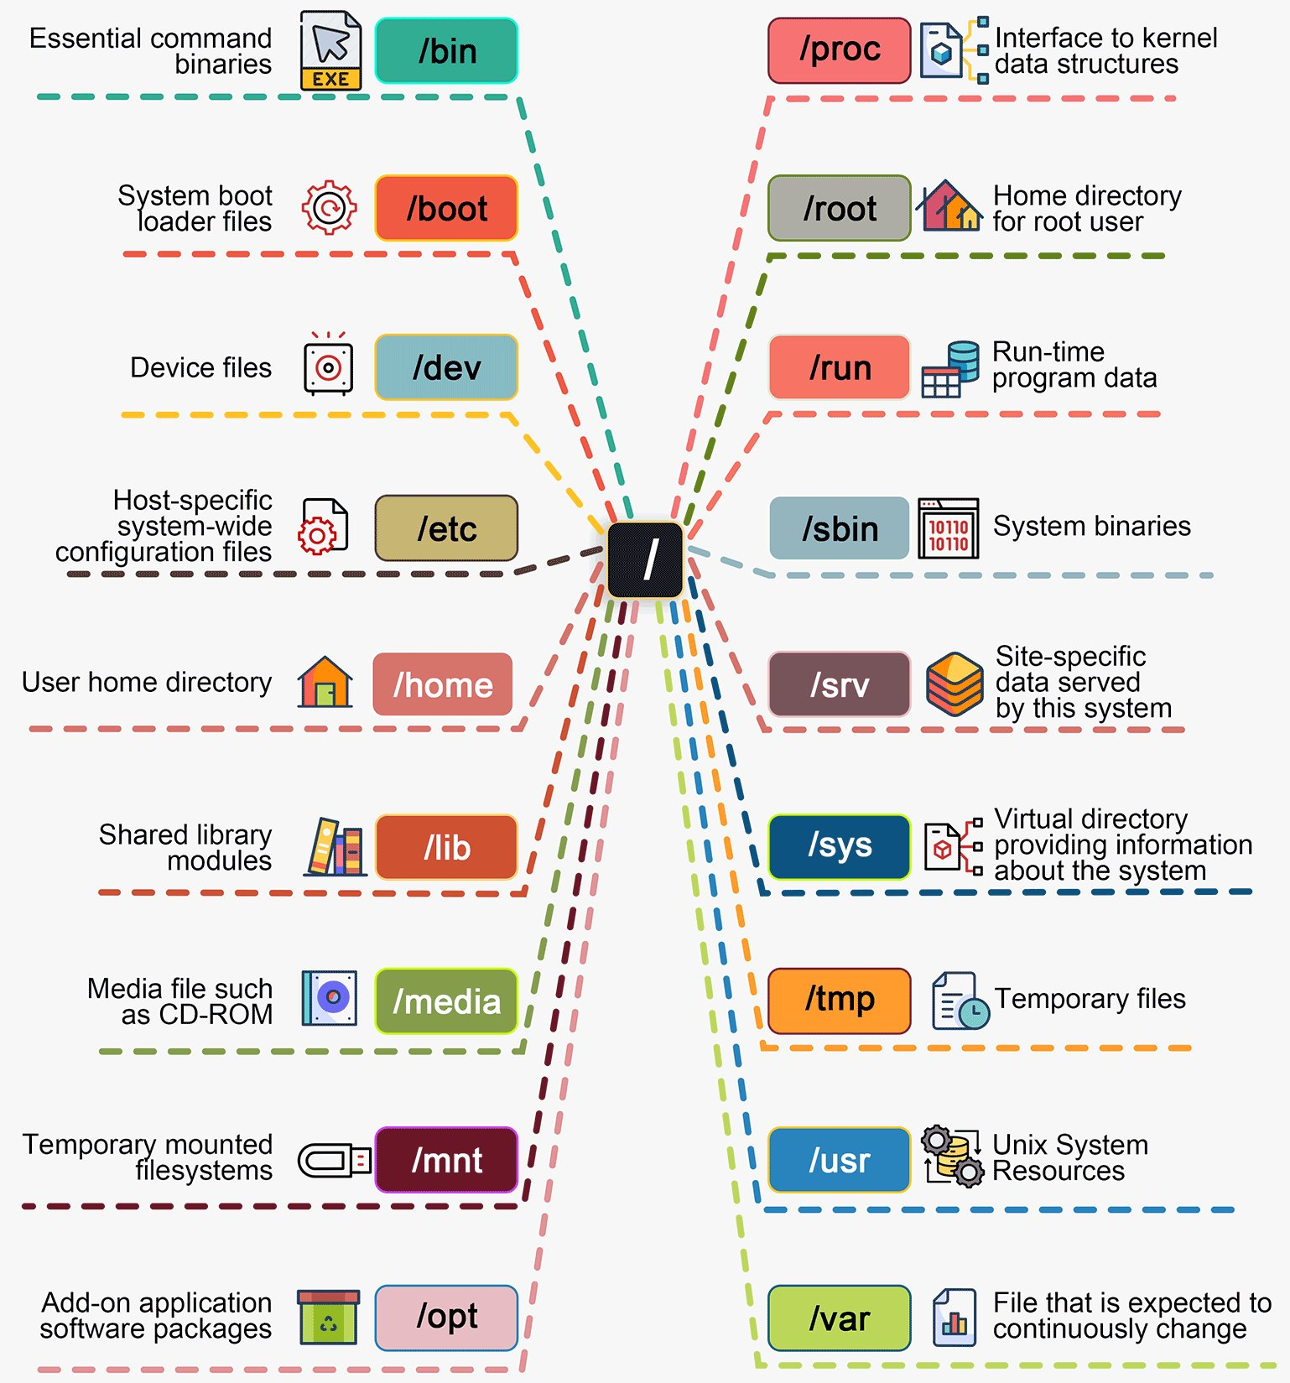
Linux file systems
Root
directory
The root directory is a special directory that contains all of the other files and directories on the computer. The root directory is specified as a / at the beginning of a path
user_name directory (or folder):
/home/khainguyen/
/home/vanA/
/home/vanB/
https://x.com/bytebytego/status/1764911444993495121

Slide 50
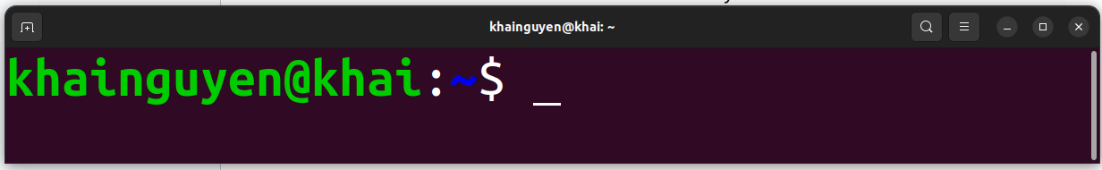
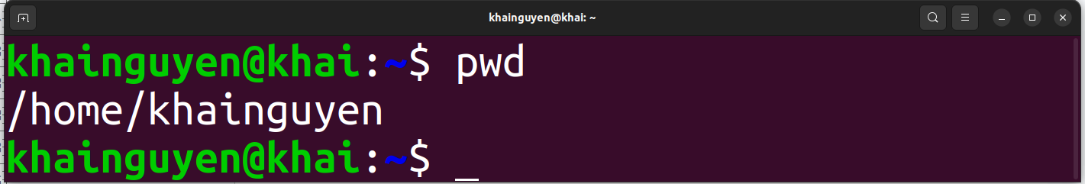

When opening the terminal, default:
$ means non-root user
tell you the computer is ready to accept a command
command
prompt
cursor
user_name
host name
The tilde ( ~ ) represents the home directory of the currently logged in ‘user_name’
This case, user_name is khainguyen, so the path is: /home/khainguyen
ENTER
To print the current path, type the command: pwd
,then hitting the ENTER key on keyboard to run the command
stands for ‘print working directory’

Slide 51
A basic command, could be:
Example: ls command
The command line will be read from left to right by the shell once press ENTER
command
(must have)
a space
option/flag
(optional)
hyphen-prefixed characters
a space
parameter
(optional)

Slide 52
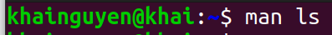
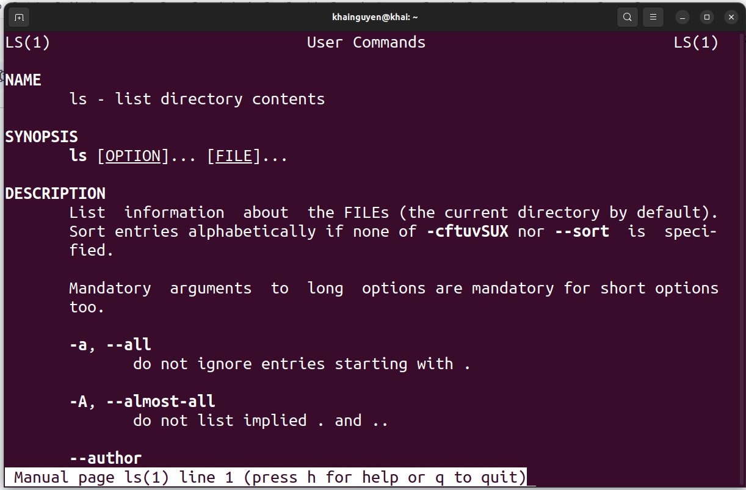
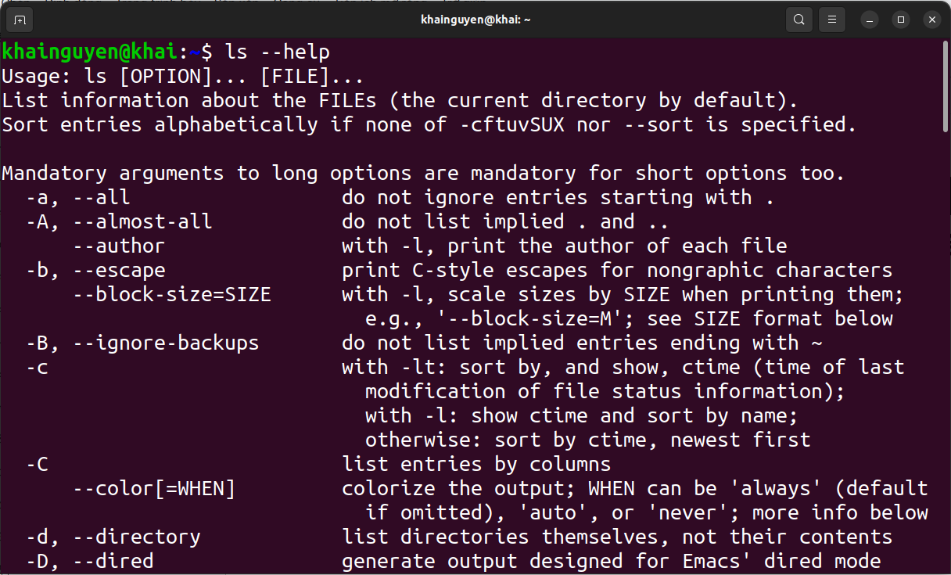
How do I know what options a command has?
man command_name
command_name --help
Example: ls command
Press q key on keyboard to exit

Slide 53
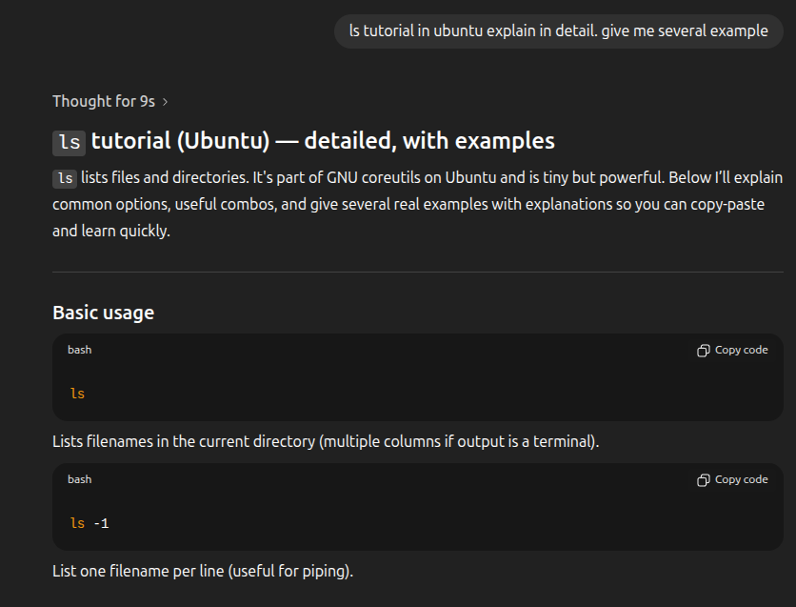
Using chat GPT to learn code

Slide 54
2. Some basic Linux commands work with files and directories

Slide 55
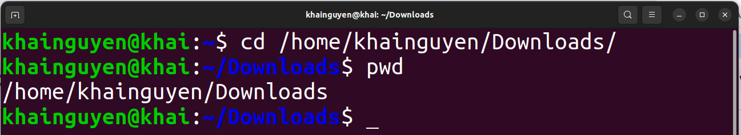
change working directory
cd command, an abbreviation for ‘change directory’.

Slide 56
Path shortcuts
~ the home directory of the currently logged in ‘user_name’
/ the root directory
. the current directory (or the working directory)
.. the parent directory of the working directory
../.. the parent directory of the parent directory of the working directory

Slide 57
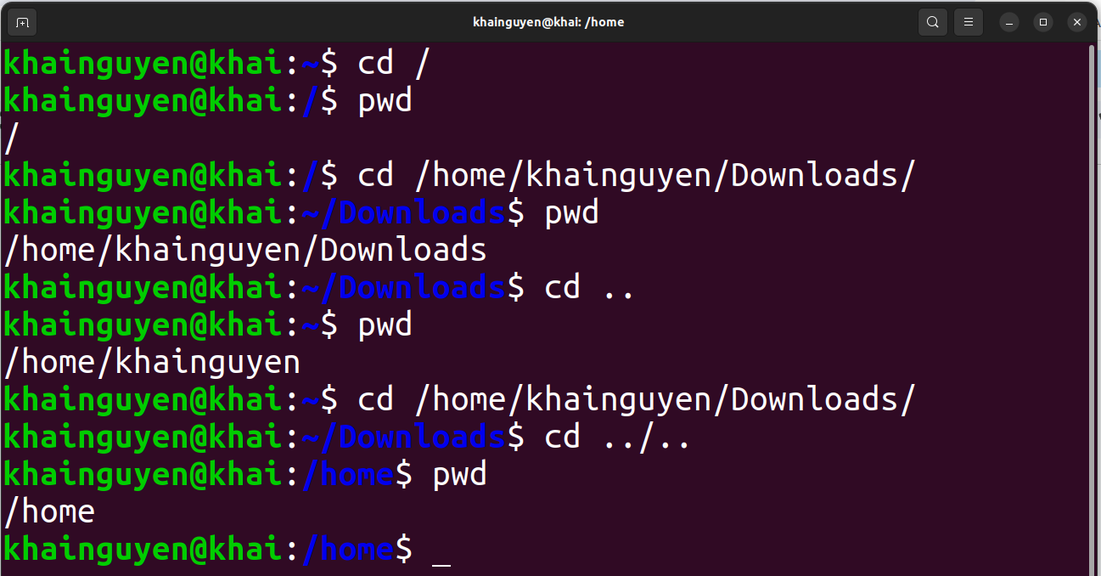
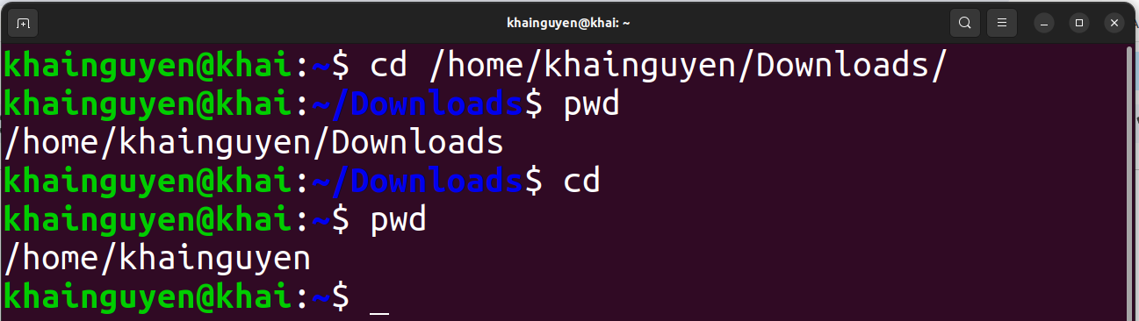
just cd to change to ~

Slide 58
Absolute path: from the root directory to the interest directory/file.
Relative path: from the working directory to the interest directory/file.
Absolute path
Relative path

Slide 59
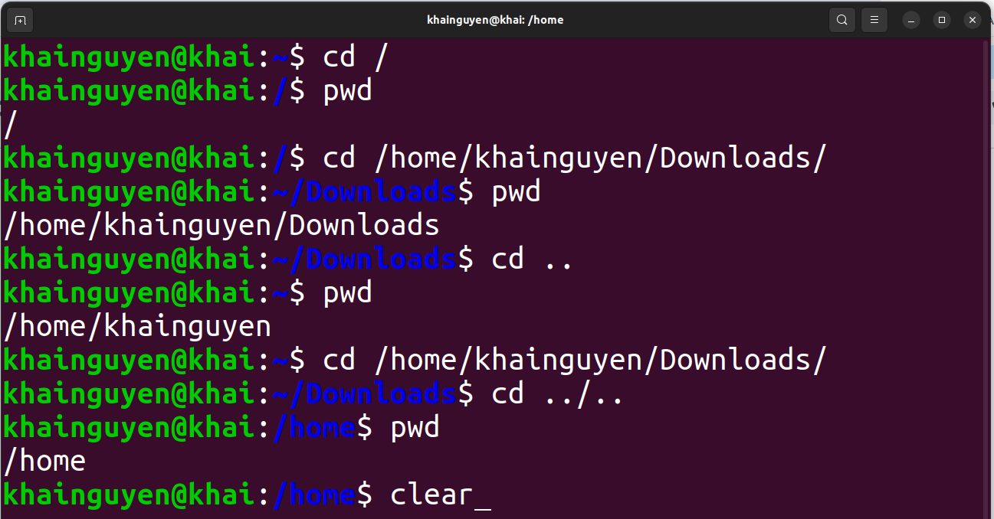
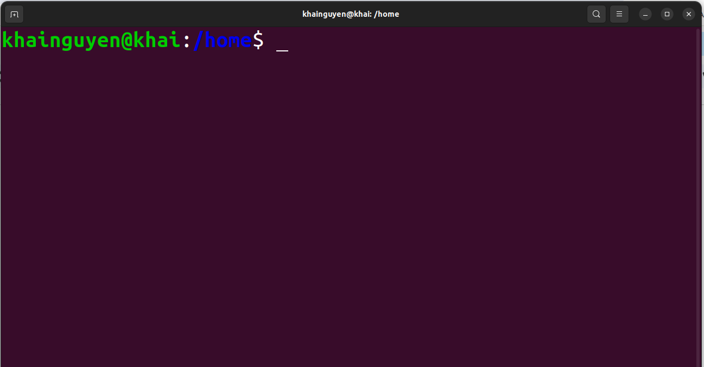
Clean up all the command lines and results above, with command: clear
ENTER
or using: Ctrl-L

Slide 60
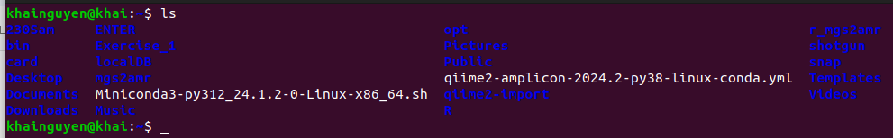
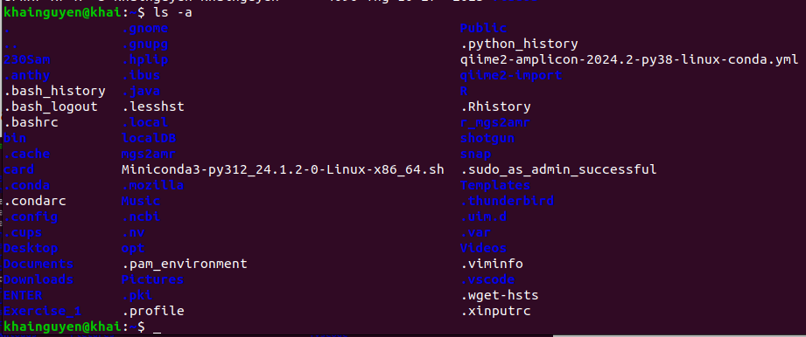
Listing content (files and subdirectories) of a directory
with command: ls (“ls" stands for “list”)
list files and directories in current directory (in short format):
ls
list all files and directories in current directory (in short format):
ls -a
or
ls --all
ls --help

Slide 61
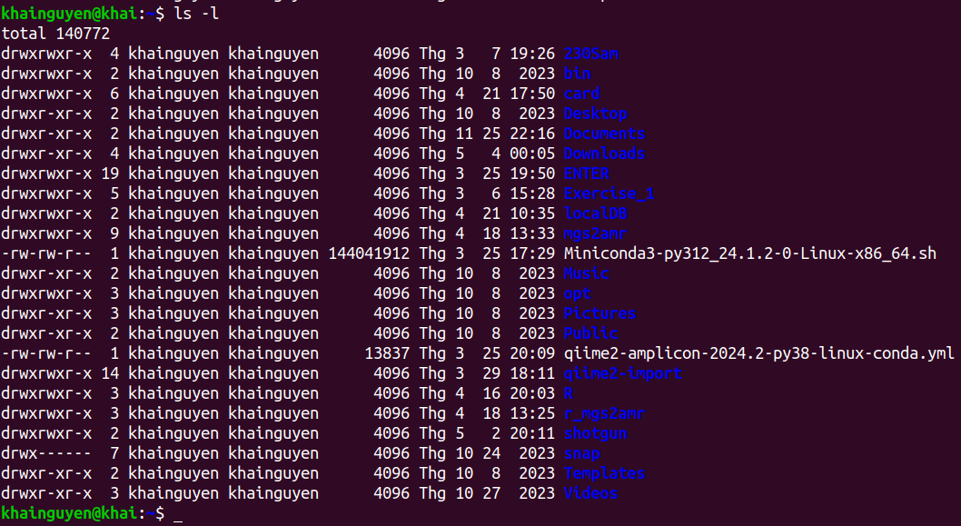
list files and directories in current directory (in long format):
ls -l
ls --help

Slide 62


list all files and directories in current directory (in long format):
ls -al

Slide 63

list files and directories in another directory (in long format):
ls -l path_to_directory

Slide 64
File type:
“d” means this is a directory
Permissions
Owner of file
(user_name)
user group
size
(in bytes)
Last modification time
directory/file name
number of hard links

Slide 65

Create and remove directory
Create a directory named “Huka” in the current directory (~) , with the command: mkdir
mkdir Huka
or
mkdir ./Huka
“mkdir” stands for “make directory”
Run “ls" to check
a new directory is created

Slide 66
Create and remove directory
Create three directory named “Huki”, “Huka", “Huke" in the current directory
mkdir Huki Huka Huke
Delete a empty directory named “Huka” in current directory, with command: rmdir
rmdir Huka
“rmdir” stands for “remove directory”
Delete a non-empty directory named “Huka” in current directory, with the command “rm”, option -r:
rm -r Huka
or
rm -R Huka
or
rm --recursive Huka/
“rm” stands for “remove”
rm --help

Slide 67

Create and remove file
Create and edit text file with nano, a text editor
1. Create a text file named “uuu" (“uuu” doesn't exist):
nano
or
nano uuu

Slide 68


2. Exit nano: ctrl + x
3. Type “y" to save:
Edit the file name if you don't want the name "uuu"
4. Finish: press ENTER key
We can view the file “uuu" with nano by run (if the file exist in current directory):
nano uuu
Create a empty file named “uuu", with “touch” command :
touch uuu
rm uuu
Delete a (empty or non-empty) file named “uuu” in current directory, with the command “rm”:

Slide 69


View the file with another commands
View the file with command: less
ENTER
press “q" key to quit
View the file with command: cat

Slide 70
Copy and move file/directory
Copy a file named “uuu” in the current directory to ./Download/, with command: cp
cp ./uuu ./Download/
“cp” stands for “copy”
Copy three the file named “uuu”, “iii", “yyy" in the current directory to./Download/
cp ./uuu ./iii ./yyy ./Download/
or
cp uuu iii yyy ./Download/
or
cp ./{iii,yyy,uuu} ./Downloads/
Create a copy of the file named "uuu" with a different name "ooo" in the current directory
cp ./uuu ./ooo
Copy a empty directory named “Huka” in the current directory to ./Download/
cp ./Huka/ ./Download/
note again: ./ means the current directory

Slide 71
Copy and move file/directory
Copy a non-empty directory named “Huka” in the current directory to ./Download/
cp -r ./Huka/ ./Download/
Move a file named “uuu” in the current directory to /home/khainguyen/Download/, with command: mv
mv ./uuu ./Download/
“mv” stands for “move”
Move a empty directory named “Huka” in the current directory to /home/khainguyen/Download/
mv ./Huka/ ./Downloads/
if Huka/ is a non-empty directory, add -r option:
mv -r ./Huka/ ./Downloads/
Rename a file named “uuu” to “eee":
Rename a directory named “Huka” to “Huko":
mv ./uuu ./eee
mv ./Huka/ ./Huko/

Slide 72



Shortcuts:
∙ Ctrl-C stops the current in-progress command and/or
Ctrl-C
∙ Up arrow key: shows previous commands
∙ history command: will show the history of commands you have run.

Slide 73



Shortcuts:
∙ Ctrl-A moves the cursor to the beginning of the line.
∙ Ctrl-E moves the cursor to the end of the line.
∙ Tab key automatically completes commands.
type “c"
have the same “Do”
press tab
press tab a second time
∙ Ctrl-D exit the terminal.

Slide 74
Summary
pwd | print working directory (or current directory) path
cd | change working directory
ls | Listing content (files and subdirectories) of the directory
clear | clean up all the command lines and results above
mkdir | create the directory
rmdir | delete the empty directory
rm | delete file
rm -r | delete non-empty (or empty) directory, delete file

Slide 75
Summary
nano | a text editor: create, view, edit the text file
touch | create the empty file
less | view text file page by page
cat | Print the content of the text file to the terminal
cp | copy file/directory
mv | move file/directory, rename file/directory
man command_name | Instructions for using the command
command_name --help

Slide 76
Homework
Move to the “Documents” directory in “user_name" directory in home directory. Use: cd
Solve the questions below while still in the “Documents” directory
Create 01 directory named “bio1” in “Documents” directory. Use: mkdir
Create 01 file named “chr1” in “bio1" directory. Use: touch or nano
Create 02 directories named “bio2” and “bio3” in “Documents” directory, with one command line. Use: mkdir
Create: 2 files named “chr2” and “chr3” in “bio2" directory, 2 files named “chr4” and “chr5” in “bio3" directory, with one command line. Use: touch or nano
Copy “chr2" file into “bio1" directory, with a different name “c2"t. Use: cp
Delete all newly created files and folders above, with one command line. Use: rm -r

Slide 77
Basic Linux commands part 2
Adapted and modified slides from Nguyen Quang Khai
Nov 9, 2025
hagiahuy311@gmail.com HuyHa

Slide 78
Summary
pwd | print working directory (or current directory) path
cd | change working directory
ls | Listing content (files and subdirectories) of the directory
clear | clean up all the command lines and results above
mkdir | create the directory
rmdir | delete the empty directory
rm | delete file
rm -r | delete non-empty (or empty) directory, delete file

Slide 79
Summary
nano | a text editor: create, view, edit the text file
touch | create the empty file
less | view text file page by page
cat | Print the content of the text file to the terminal
cp | copy file/directory
mv | move file/directory, rename file/directory
man command_name | Instructions for using the command
command_name --help

Slide 80
Homework
Move to the “Documents” directory in “user_name" directory in home directory. Use: cd
Solve the questions below while still in the “Documents” directory
Create 01 directory named “bio1” in “Documents” directory. Use: mkdir
Create 01 file named “chr1” in “bio1" directory. Use: touch or nano
Create 02 directories named “bio2” and “bio3” in “Documents” directory, with one command line. Use: mkdir
Create: 2 files named “chr2” and “chr3” in “bio2" directory, 2 files named “chr4” and “chr5” in “bio3" directory, with one command line. Use: mkdir
Copy “chr2" file into “bio1" directory, with a different name “c2". Use: cp
Delete all newly created files and folders above, with one command line. Use: rm -r

Slide 81
Contents
I. Working with text file.
1. Search and filter.
2. Input/output redirection.
II. Some other commands
3. Download file.
4. File permission.
5. Compress and decompress.

Slide 82
1. Search and filter

Slide 83




Search and filter
find command: search for files or directories in a directory
Search for files and directories named "vui", with -name option:
Search for directories named "vui", with -type option, d means directory:
Search for files named "vui", with -type option, f means file:
don't remember the file name clearly, but there is "vu" at the beginning of the name:
* means zero or any characters

Slide 84


Search and filter
head command: prints the first few lines in the file
Default: prints the first 10 lines in the file:
print the first #number lines instead of the first 10

Slide 85


Search and filter
tail command: prints the last few lines in the file
Default: prints the last 10 lines in the file:
print the last #number lines instead of the last 10

Slide 86




Search and filter
wc command: print newline, word, and byte counts for each given file
Default:
select which counts are printed:
13 lines, 14 words, 32 bytes
wc --help: A word is a non-zero-length sequence of characters delimited by white space.

Slide 87





Search and filter
cut command: Print selected parts of lines from each FILE
Specify fields separated by a space,
printing the 2nd field:
Print the 3rd character, 5th to 7th characters of the file:
use --only-delimited option: do not print lines not containing delimiters
cut --help:

Slide 88





Search and filter
grep command: print lines that match patterns
Default: case-sensitive
--line-number option: Display the matched lines and their line numbers.
--count option: print a count of matching lines
--ignore-case option: case-insensitive
--invert-match option: print non-matching lines

Slide 89
2. input/output redirection

Slide 90


input/output redirection
Piping
Pipe is formed using the vertical dash |
A | B | output of command A will be input of B command.
A | B | C output of command A will be input of B command, output of command B will be input of C command.
The pipe is used to combine two or more commands.
Example:
ls | grep “Do"
ls's output
grep's input
grep's output

Slide 91


input/output redirection
Output redirection: The ">" character
To redirect output to a file
If the view.txt file already exists, its content will be overwritten

Slide 92



input/output redirection
If you do not want the content to be overwritten, use the ">>" character
Input redirection: The "<" character

Slide 93
3. Download file

Slide 94


Download file
wget command: Downloader
Default: Download file from a URL
--output-document option: download file from URL, with a different name

Slide 95


Download file
--input-file option: download from multiple URL
1. Create a text file containing URLs, each line includes a URL, use: nano.
2. wget --input-file link_down.txt

Slide 96
4. File permission

Slide 97
When run: ls -l
user (or owner)
permission
other
permission
Owner of file
(user_name)
user group
group
permission
snap directory
- User permission: read (yes), write (yes), execute (yes).
- Group permission: read (no), write (no), execute (no).
- Other permission: read (no), write (no, execute(no).
Meaning of r, w, x, -:
r = readable
w = writeable
x = executable
- = denied
Templates directory
- User permission: read (yes), write (yes), execute (yes).
- Group permission: read (yes), write (no), execute (yes).
- Other permission: read (yes), write (no), execute (yes).

Slide 98

Permission Attributes
https://shorturl.at/prOPY

Slide 99



chmod: Change File Mode
To change the mode (permissions) of a file or directory, use the chmod command.
chmod supports two distinct ways of specifying mode changes:
1. Octal number representation
rwx
(user)
r-x
(group)
r-x
(other)
File Modes in Binary and Octal
https://shorturl.at/prOPY

Slide 100




chmod: Change File Mode
2. Symbolic representation
chmod Symbolic Notation
If no character is specified, “all” will be assumed.
+ a permission is to be added.
- a permission is to be taken away.
= only the specified permissions are to be applied and that all others are to be removed.
Permission:
r readable
w writeable
x executable
https://shorturl.at/prOPY

Slide 101
5. Compress and decompress

Slide 102

Compress and decompress
tar command: compress and decompress
Compress all files and directories in the “Documents" directory to a compressed file named “doc.tar.gz"
-c --create: create a new archive file
-z, --gzip: Using gzip to compress
-f or --file: compressed file name
-v or --verbose: Verbosely list files processed
The four options "-c -v -z -f" can be written as "cvzf"

Slide 103

Compress and decompress
Decompress a compressed file named “doc.tar.gz"
-x, --extract: Extract files from an archive.

Slide 104
Summary
find | search for files or directories in a directory
head | prints the first few lines in the file
tail | prints the last few lines in the file
wc | print newline, word, and byte counts for each given file
cut | Print selected parts of lines from each FILE
grep | print lines that match patterns

Slide 105
Summary
| | pipe
“>”, “>>” | output redirection
“<” | input redirection
wget | download file from <link>
chmod | Change File Mode
tar | compress and decompress

Slide 106

Homeworks
1. Create a directory named “hw2".
2. Move to “hw2" directory, and download this file (SRR25653406.fasta.tar.gz) using wget command:
https://github.com/UeenHuynh/MGMA_2024/raw/main/lecture_2/2.%20basic%20Linux%20commands%20part%202/SRR25653406.fasta.tar.gz
3. Decompressing this file SRR25653406.fasta.tar.gz using tar command.
Additional information about FASTA format (The file has the extension .fasta, .faa, .fna, etc.):
FASTA format is a text-based format, contains two lines:
- First line: is the comment (description) line.
+ Always starts with “>” sign (This information is useful for the exercise).
+ Give basic information about the sequence (nucleotide or amino acid).
- Second line: The actual sequence of the first line description, using a standard one-letter character string.
Example:
(https://www.ncbi.nlm.nih.gov/nuccore/M35309.1?report=fasta)
=> Let's call this single-sequence FASTA format (https://en.wikipedia.org/wiki/FASTA_format), so if a text file contains a single-sequence FASTA format, this file is called a single-sequence FASTA file.
If a text file contains two or more single-sequence FASTA format, this file is called a multiple-sequence FASTA file or multi-FASTA file.

Slide 107

Homeworks
An example of multi-FASTA format :
(https://www.researchgate.net/figure/A-sample-of-the-Multi-FASTA-file_fig1_309134977)
Additional information for this file: SRR25653406.fasta (after decompressing using tar command).
- This is a multi-FASTA file. It is converted from fastq to fasta format file (Don't worry about fastq format in this exercise), the original fastq format file is obtained from the sequencing machine.
- Each single-sequence FASTA in this file is information about a read - a piece of DNA sequence obtained from the sequencing machine:
+ First line: some information about the sequencing platform of this file, that's all, don't worry about the details.
+ Second line: DNA sequence of that read, a character string consisting of 4 types of letters: A, T, G, C representing 4 types of nucleotides. In addition, there is the letter N, which means 1 of 4 possible types of nucleotides, because the sequencing machine cannot identify which type of nucleotide it is.

Slide 108
Homeworks
A single-sequence FASTA in this file:
(The DNA sequence has 2 lines because the screen is not enough to display 1 line, so it is split into 2 lines)
4. How many lines does this file have? Using: wc.
5. How many reads does this file have? Using: grep for the search “^>” means the line starts with the character ">", and -c option.
6. How many reads do not have any N? Using: grep with -v, -c option; pipe.
7. Create a file named "id_read.txt" containing only the first line (the line contains information) of all reads. Using: grep with “^v"; output redirection.

Slide 109
Homeworks
8. Create a file named "part_of_id_read.txt" containing a part of the first line (the line contains information) of all reads. Using: grep; pipe; cut; output redirection.
Two lines of 1 read:
(The line containing the DNA sequence has 2 lines because the screen is not enough to display 1 line, so it is split into 2 lines).
a part of the first line of 1 reads:

